Slide 1

Professionalism on Trial: The Rise of Incivility in Law
Presented to the Law Society of Yukon
September 25, 2026
Marc D. Adler
Recovering Corporate Commercial Solicitor
Program Director, Assist
Peer Mentor
Sessional Instructor, Faculty of Law, U of C
Craig D. Boyer, K.C., Shores Jardine
Administrative Lawyer
Called in AB, Nunavut, NWT and Yukon
Peer Mentor
Community Volunteer
Mental Health Advocate

Slide 2

THANK YOU!
Thank you to the Law Society of Yukon and everyone here.
Craig and I are very grateful for this opportunity to speak with you all today about this important topic.

Slide 3
AGENDA
1. MY STORY AND WHY I’M HERE (Marc)
Living the Lawyer Paradox and My Wake-Up Call.
2. THE GENERAL LANDSCAPE: THE MENTAL HEALTH CRISIS IN LAW (Marc) Long Known. Extensively Studied. Still Unresolved.
3. ALBERTA LAWYERS’ ASSISTANCE SOCIETY (Marc)
30 Years of Confidential Support. Used by 1 in 3 Alberta Lawyers.
4. INCIVILITY AND BULLYING IN THE LEGAL PROFESSION (Marc)
How Serious is the Problem and what can we do in the moment?
5. INCIVILITY AND BULLYING IN PRACTICE: STAYING ONLINE UNDER ATTACK (Craig) Impact of Groia: Bullying as an Effective Strategy
6. THE CHOICE THAT REMAINS: Discussion between Craig and Marc
Choosing Who We Want to Be in a Profession Driven by Profit
Q&A

Slide 4
Curiosity over Condemnation
“Our curiosity is the most powerful thing we own.”
- James Cameron
Notes:
That is the spirit in which I want to approach this conversation. Incivility causes real harm, and understanding it does not mean excusing it. But if we begin and end by condemning the people involved, we may never become curious enough to understand what keeps producing the behaviour—or what might actually change it.

Slide 5
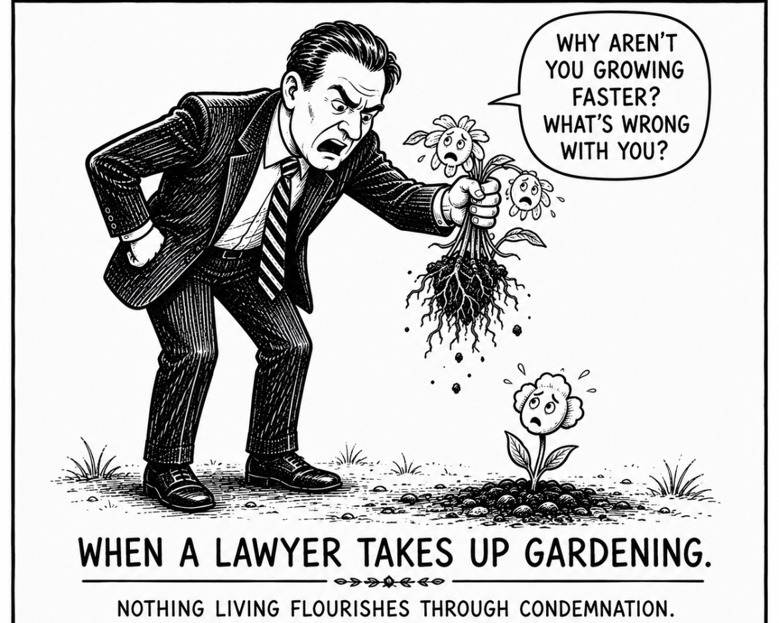

Slide 6



Slide 7
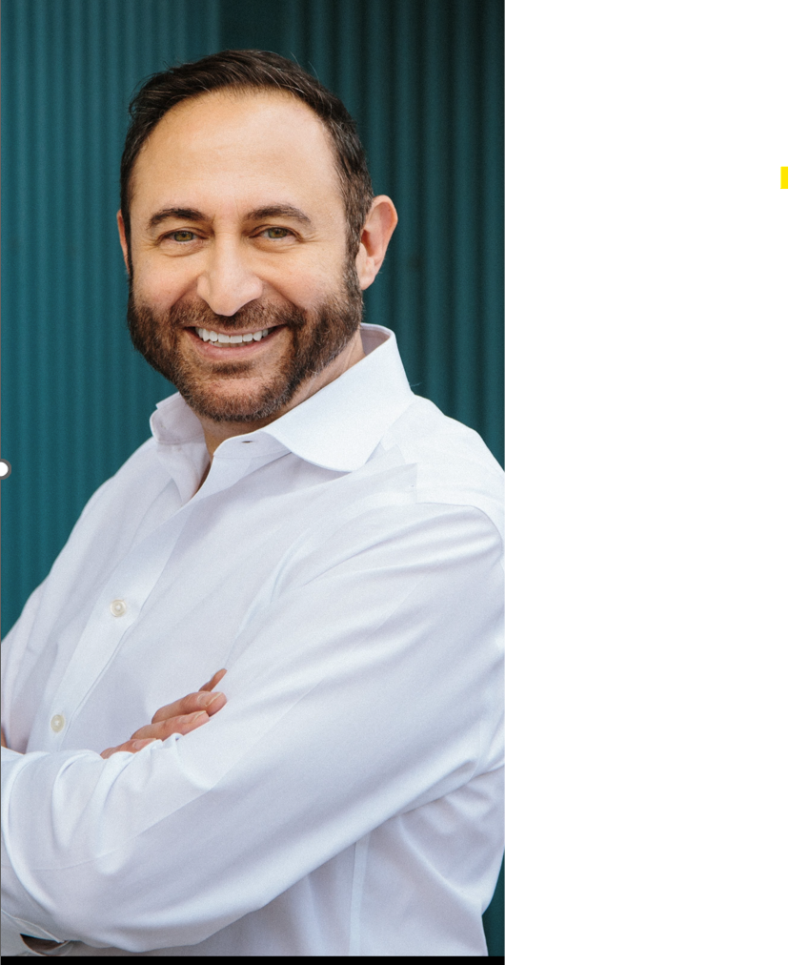
ME: DECADES INSIDE THE SYSTEM
Program director, Assist (since Feb 2025)
Created and taught law school course on Mental Health and the Legal Profession (2025 & 2026), U of C
Called in AB in 1994; BC in 2010.
15 years private practice (banking & project finance & KM): 8 firms (small, med, large).
15 years in-house, General Counsel for GE and Chief Legal Officer

Slide 8
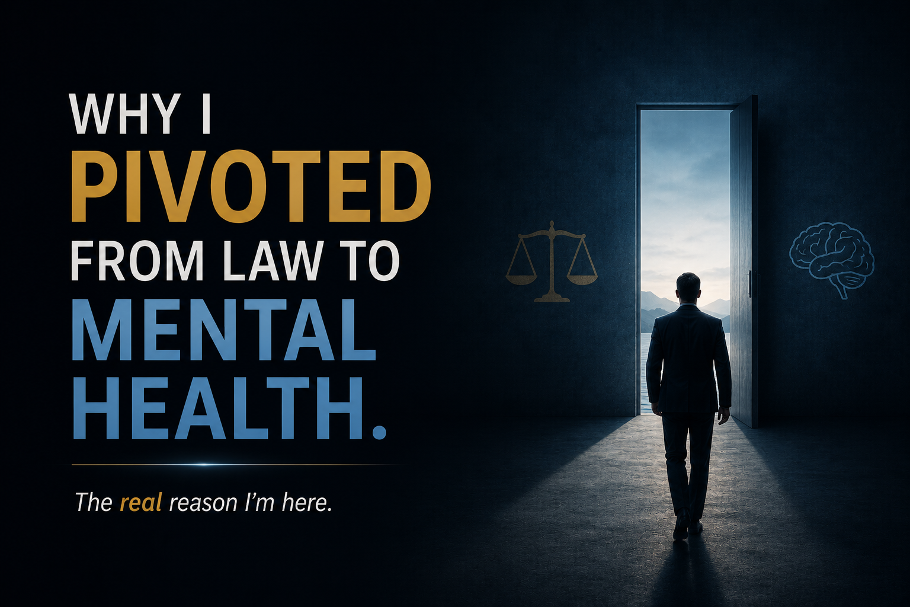

Slide 9
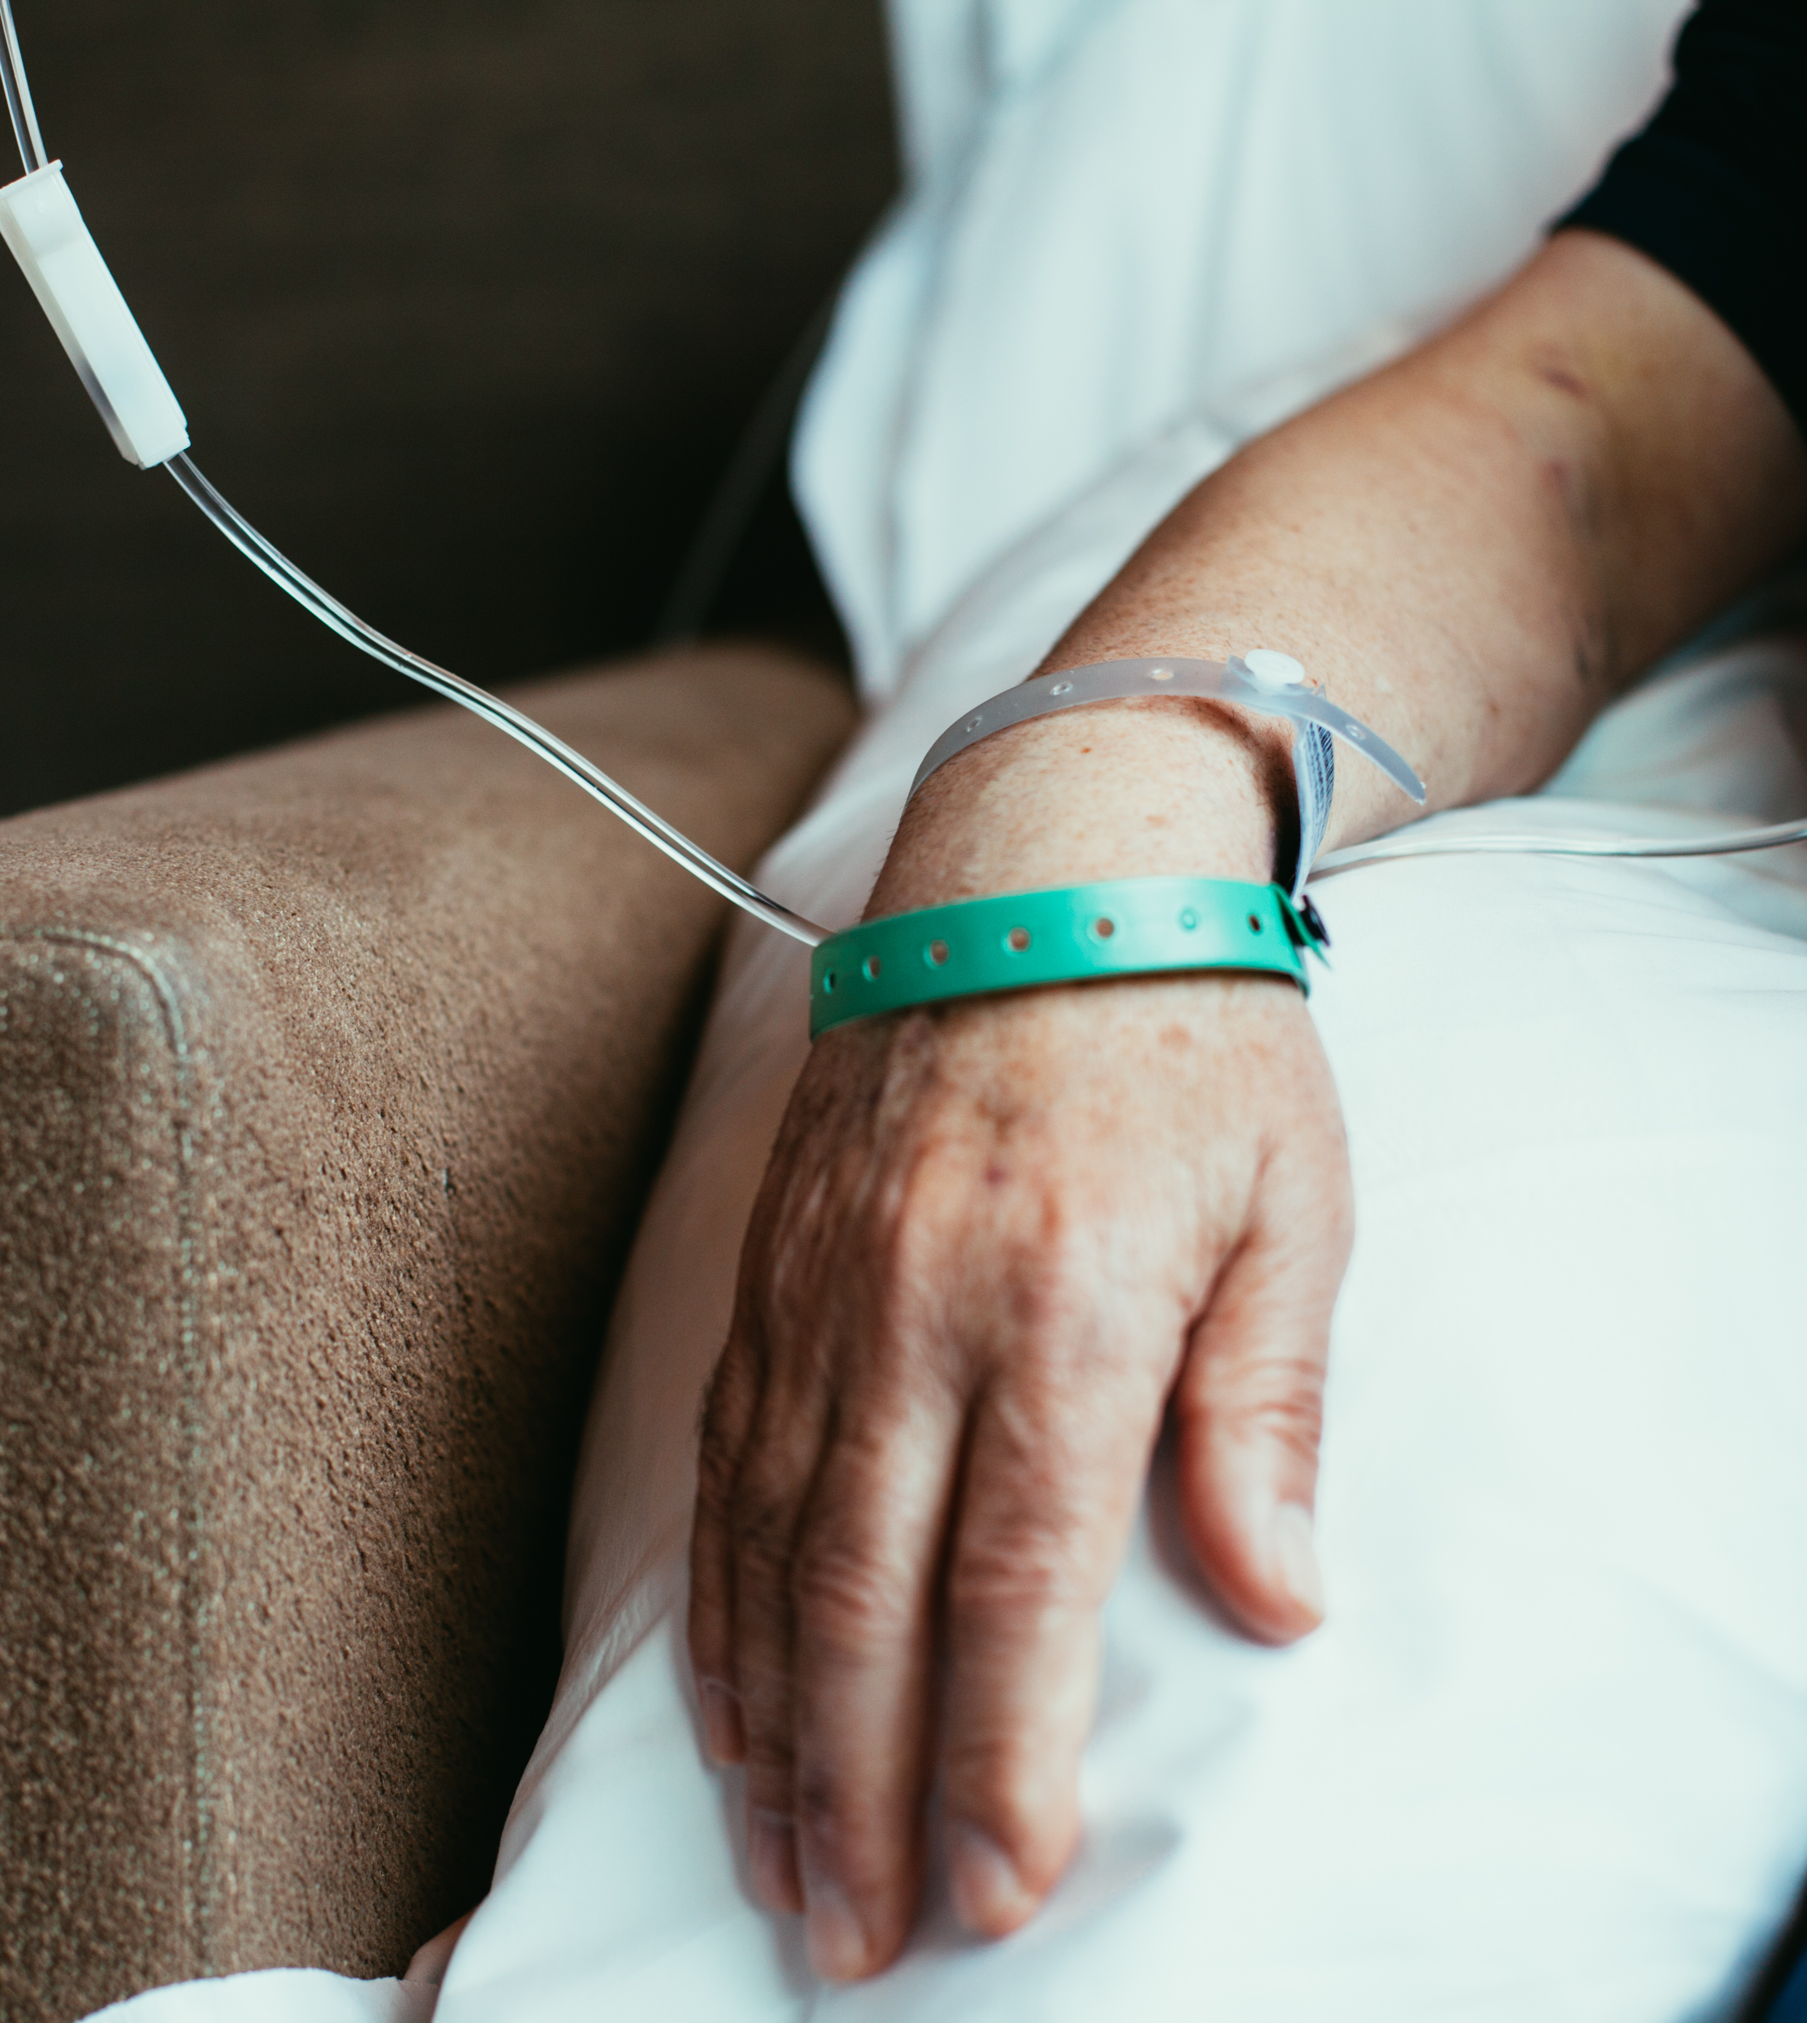
LEARNING THE HARD WAY
SACRIFICING THE HUMAN BEING DOING THE LAWYERING
IS NOT LOGICAL, INTELLIGENT OR WISE
1994 - 2015: $$$
“success” at the expense of everything else in life.
2016: CANCER!
+ Treatment resistant depression & anxiety
+ 15 years of contested divorce litigation
+ physical health decline (5 major surgeries in 5 years)

Slide 10

THE LAWYER PARADOX

Slide 11
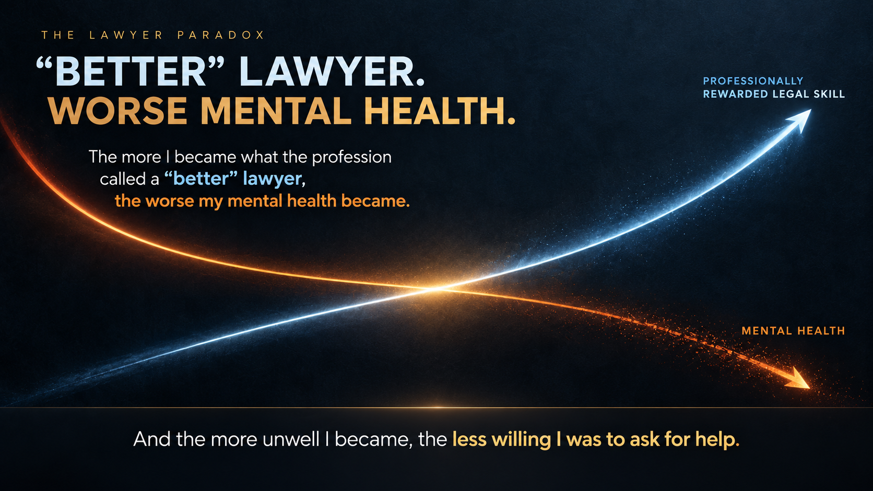

Slide 12
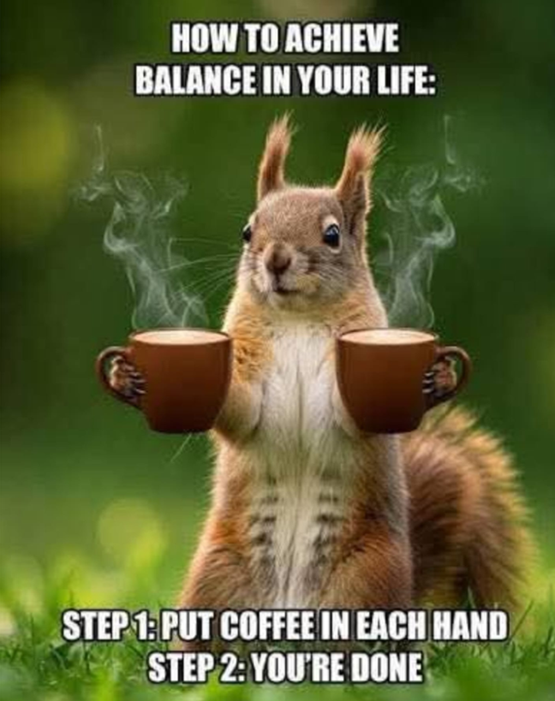
For most of my career, this was the extent of my understanding of work-life balance.

Slide 13


Slide 14
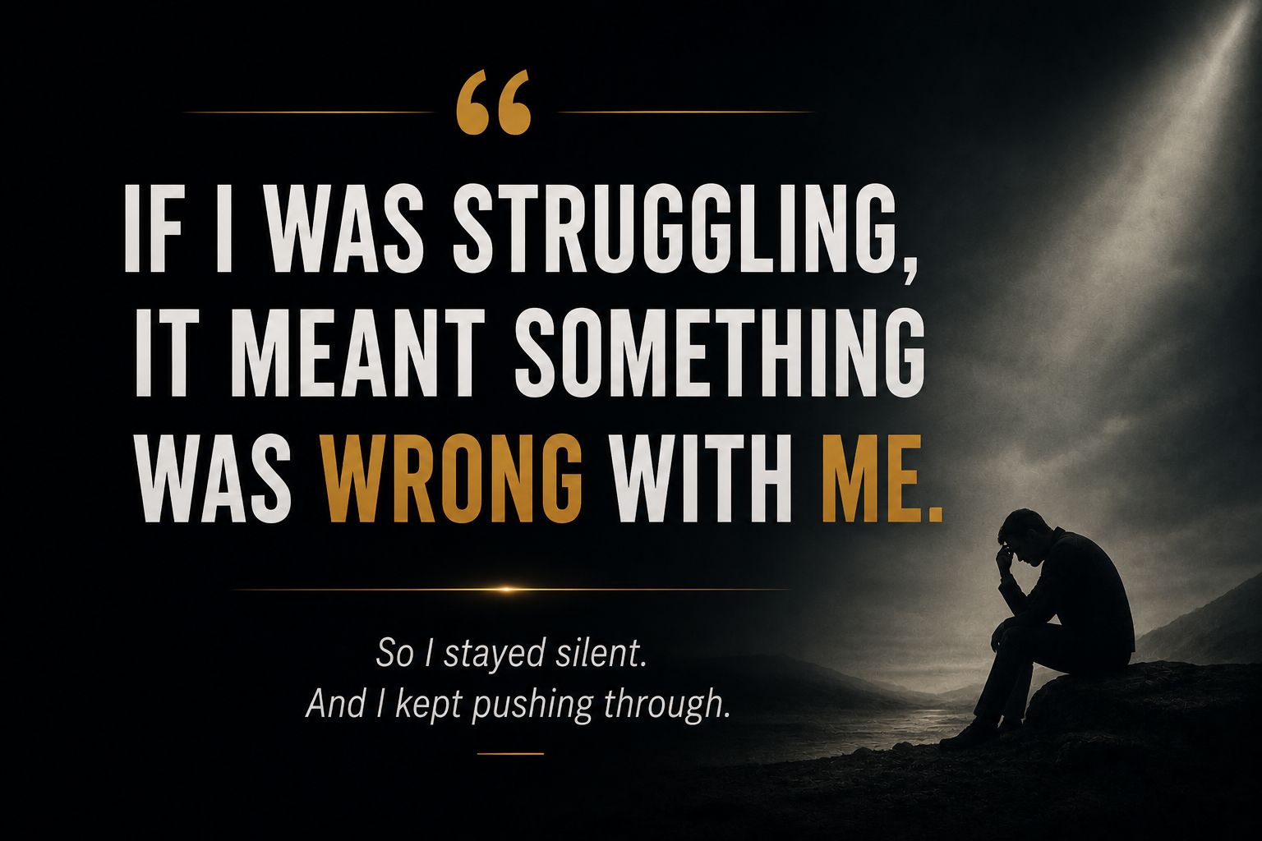

Slide 15


Slide 16
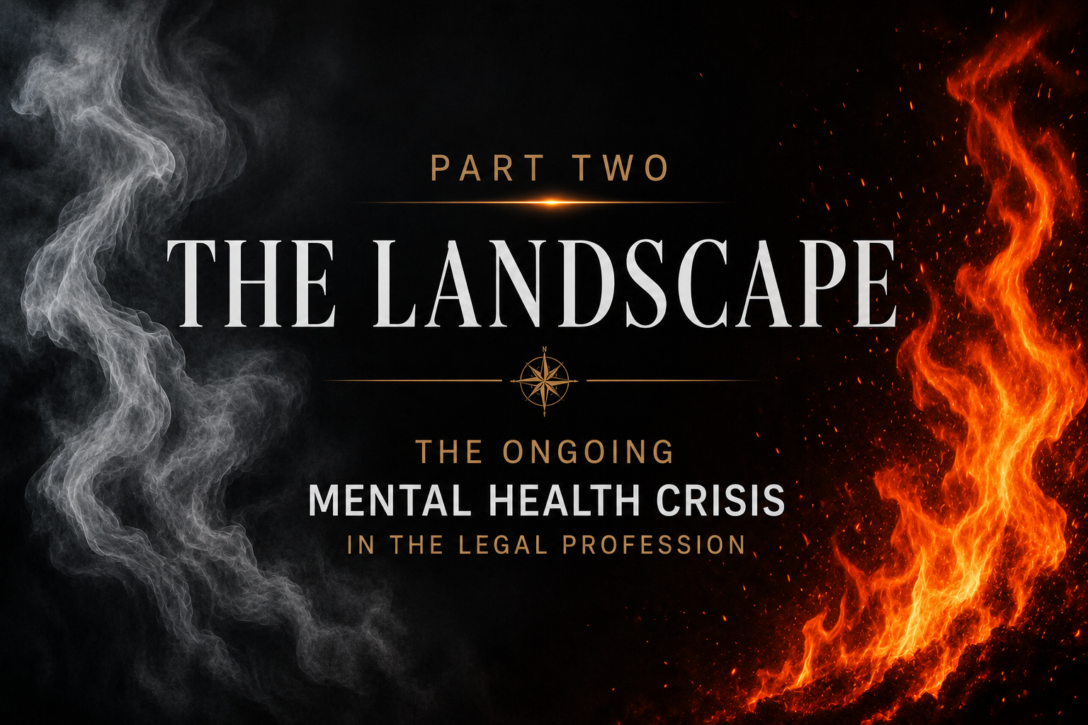

Slide 17
WHAT WE’RE SEEING: CHRONIC DISTRESS
Burnout and emotional exhaustion.
Chronic anxiety.
Depression.
Alcohol and substance use.
Additions.
Harassment/violence/incivility.
Withdrawal and isolation.
Suicide and suicidal ideation.
Physical disease (cancer, heart disease, etc)

Slide 18
2 - 3x
THE GENERAL POPULATION.
Across multiple measures of distress.
Global crisis.

Slide 19
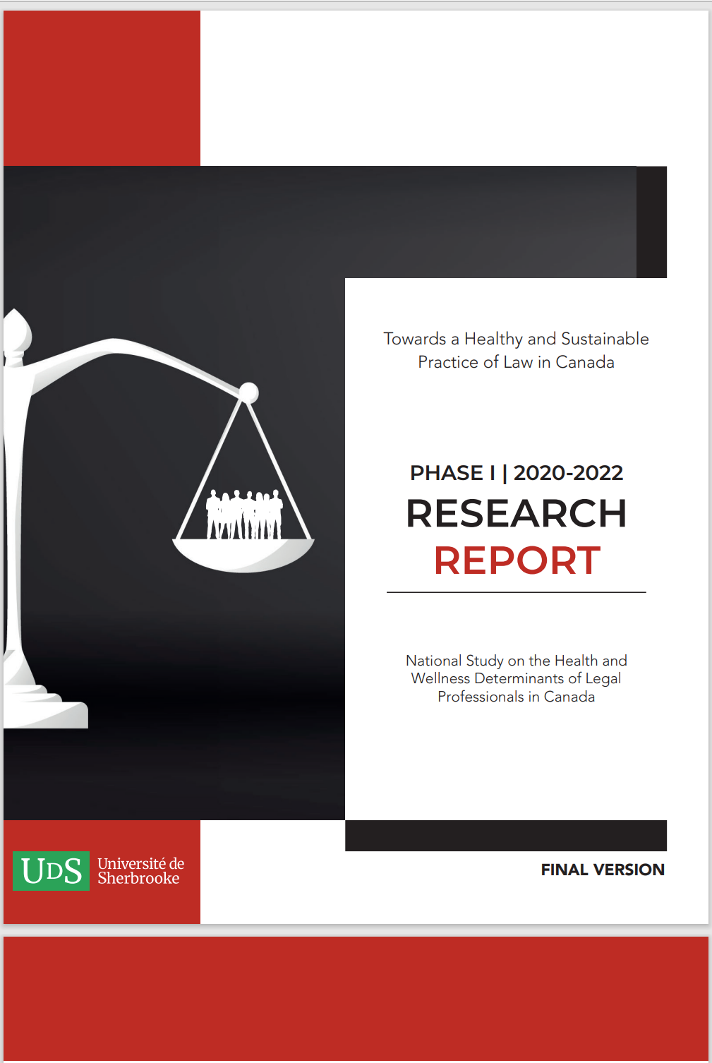
Not anecdotal anymore.
Same pattern in Canada.
Elevated levels of distress across the profession.
An “alarming picture” of the wellness of Canadian legal professionals profession.

Slide 20
2022 National Study Key Findings
 | Lawyers Canada | Lawyers Alberta | Articling Students Canada (Canada) | General Population
Major depressive disorder | 28.6% | 28.9% | 43.6% | 15%
Generalized Anxiety Disorder | 35.7% | 32.4% | 49.8% | 13%
Suicidal Ideation | 24.1% Since beginning practice | 26.2% | 19.4% (Since beginning their practice) | 11.8% (Through their lifetimes)
Psychological Distress | 57% | 55% | 72% | 40%
Burnout | 55.9% | 54.7% | 62.9% | Not stated

Slide 21
OUR MOST VULNERABLE MOST AT RISK
Law Students
Articling students
Early career
Females
Disabled
Equity Deserving Groups

Slide 22
WHY THIS SHOULD MATTER TO EVERYONE!
Global –across jurisdictions, practice areas and generations
Impacts not just lawyers but also their families, clients, the public and even society at large
Vast numbers impacted worldwide
The stakes could not be higher!
Yet VERY LITTLE URGENCY (including from the lawyers suffering the most)

Slide 23
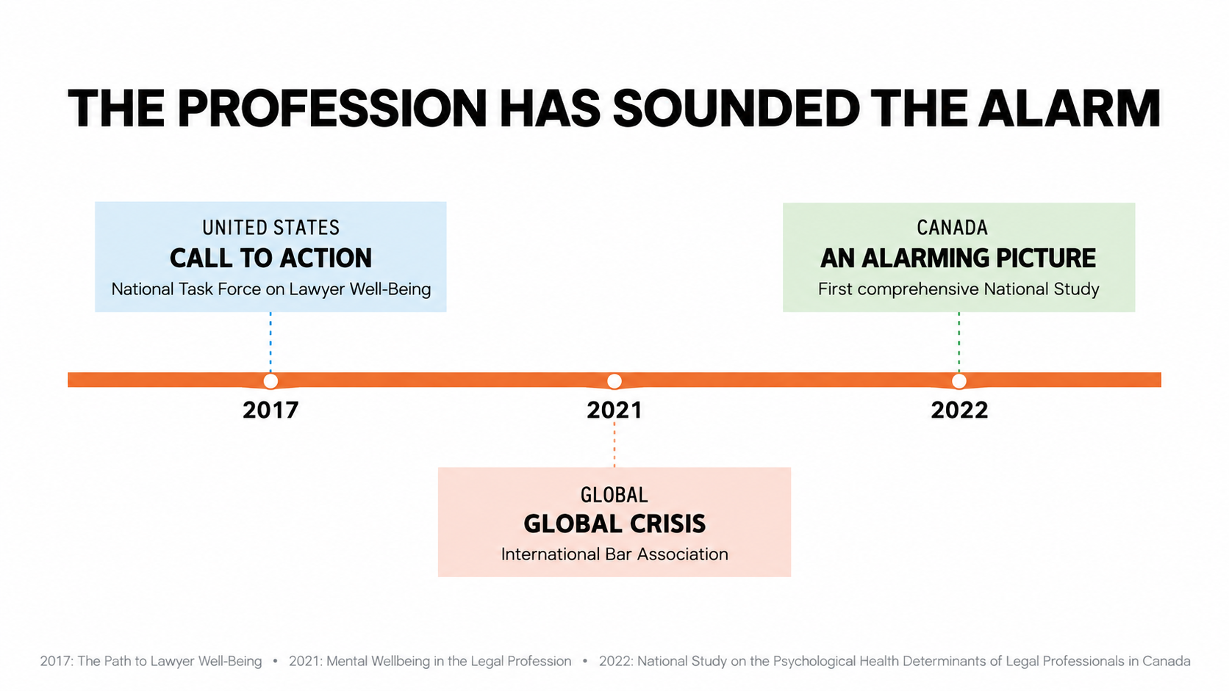

Slide 24

HOW LONG HAVE THEY KNOWN ABOUT IT?
1779
First law school in US (Williamsburg
1853
First law school in Canada (McGill
1940s
Institutional commentary on lawyer impairment - 1940s (ABA) - alcoholism and emotional strain among attorney
late 1970s
“Lawyer Unhappiness” psychological research [Elwork & Scherer (late 1970s)] - first empirical psychological studies of lawyer stress

Slide 25
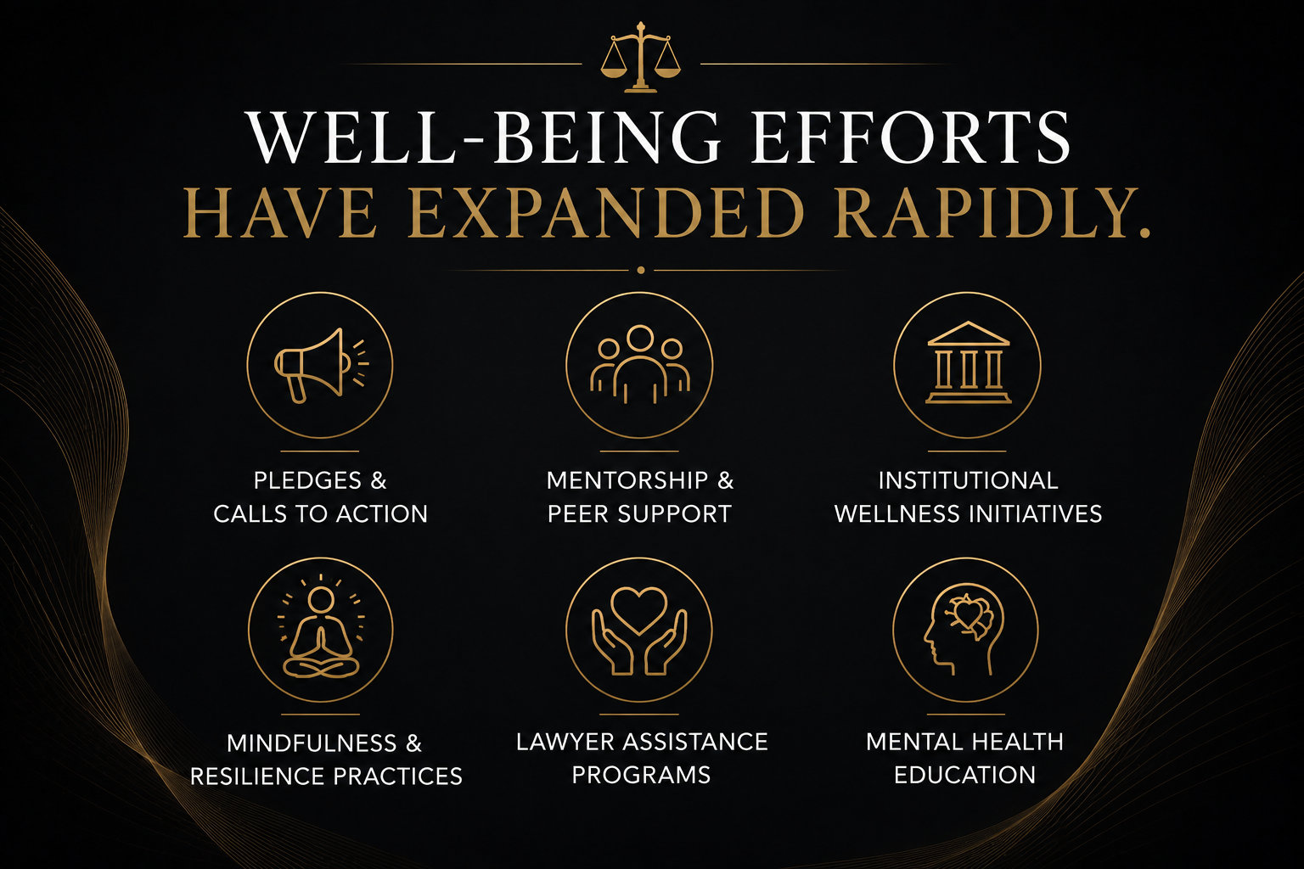

Slide 26
AND YET?

Slide 27
MAJOR DEPRESSIVE DISORDER
Lawyers:
Highest among 104 occupations
(Johns Hopkins)

Slide 28
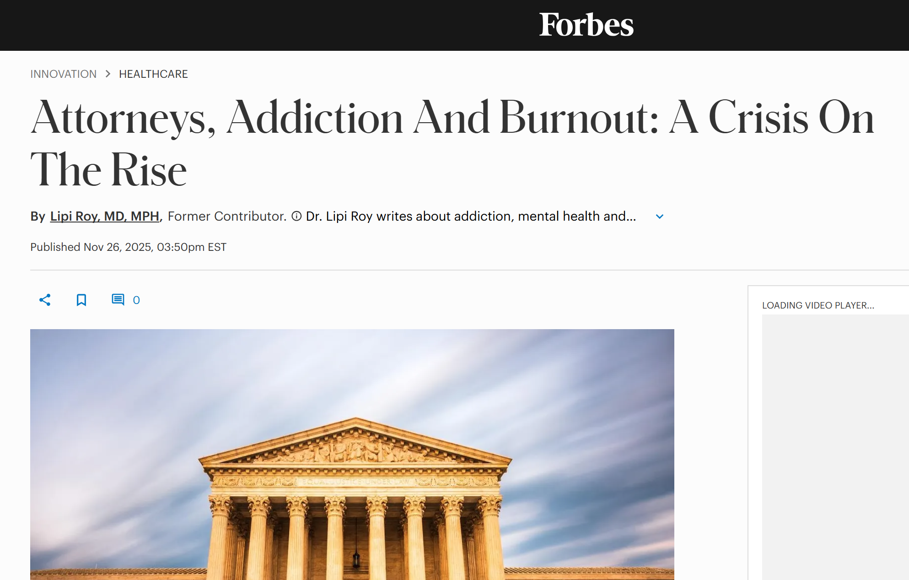

Slide 29
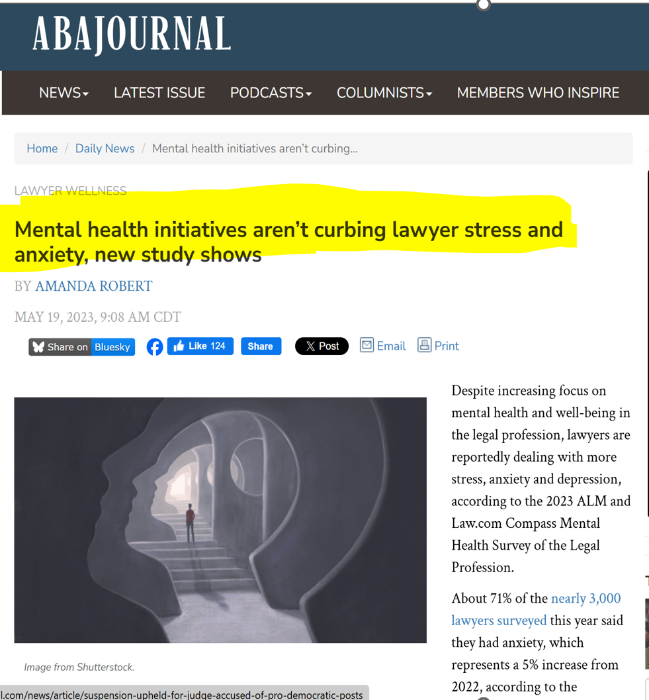

Slide 30
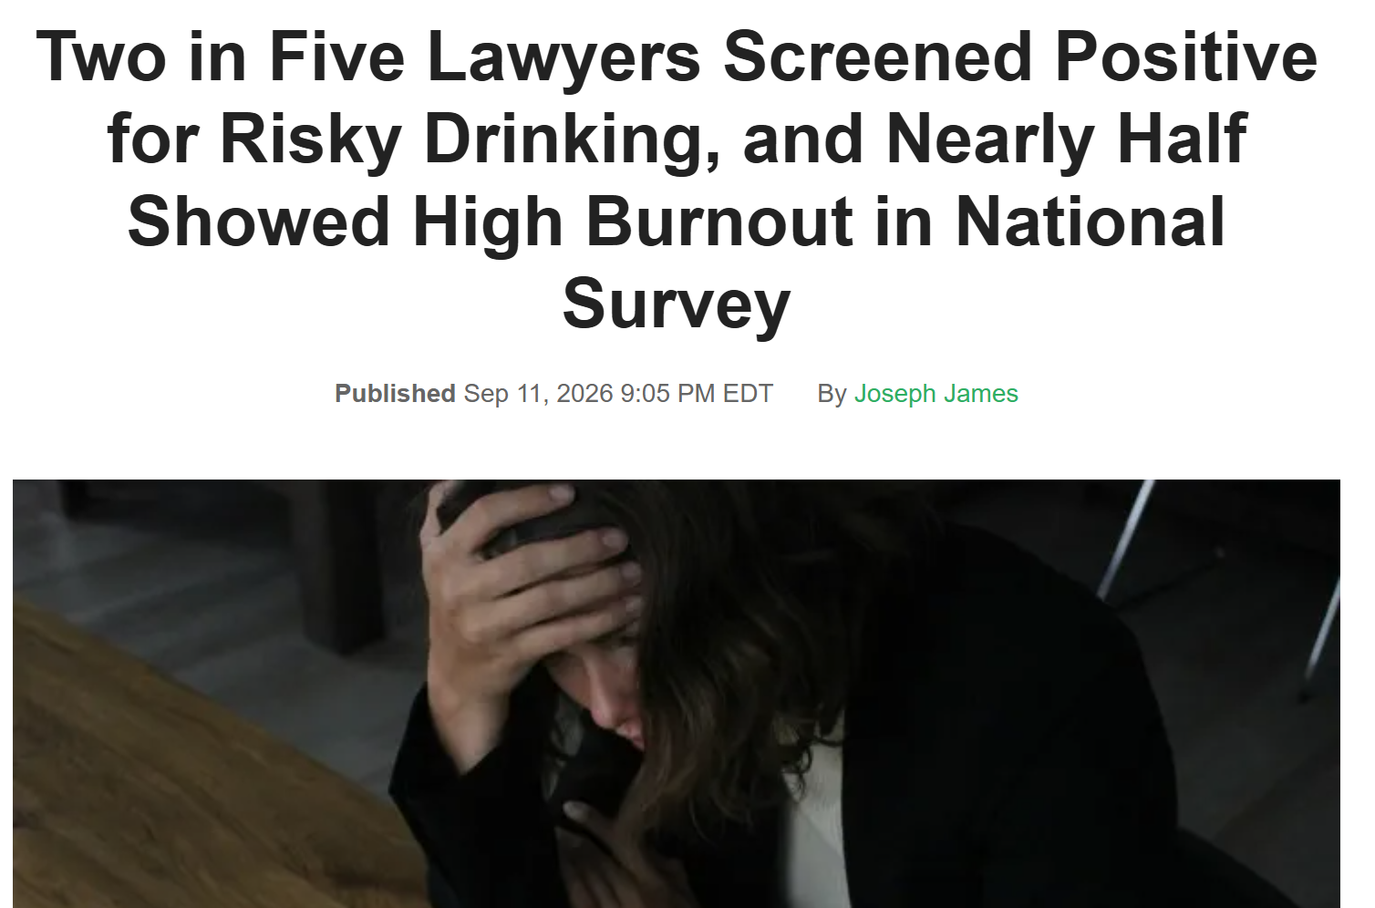

Slide 31
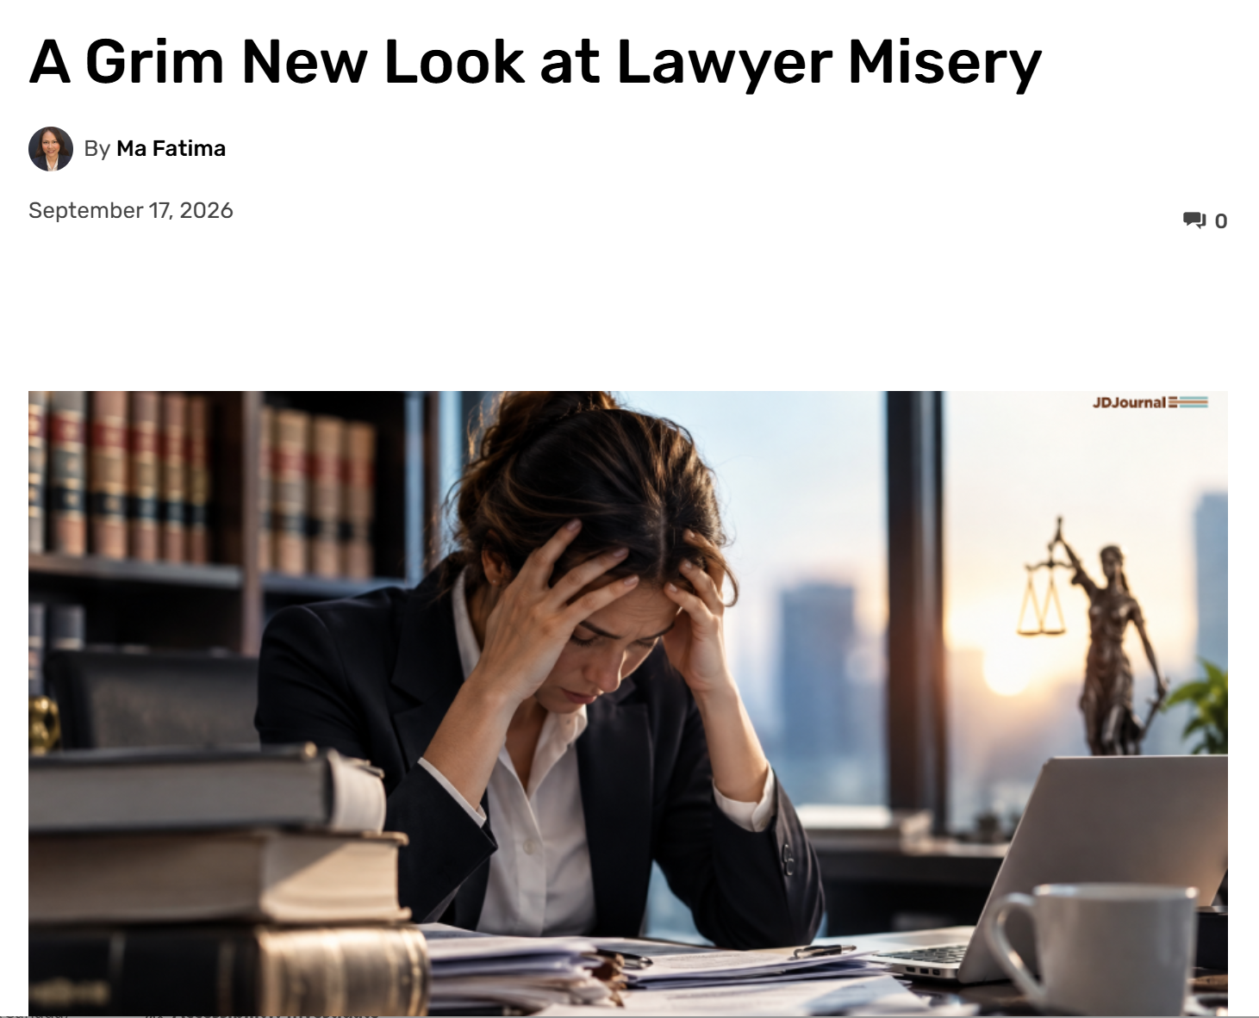
From last week….

Slide 32
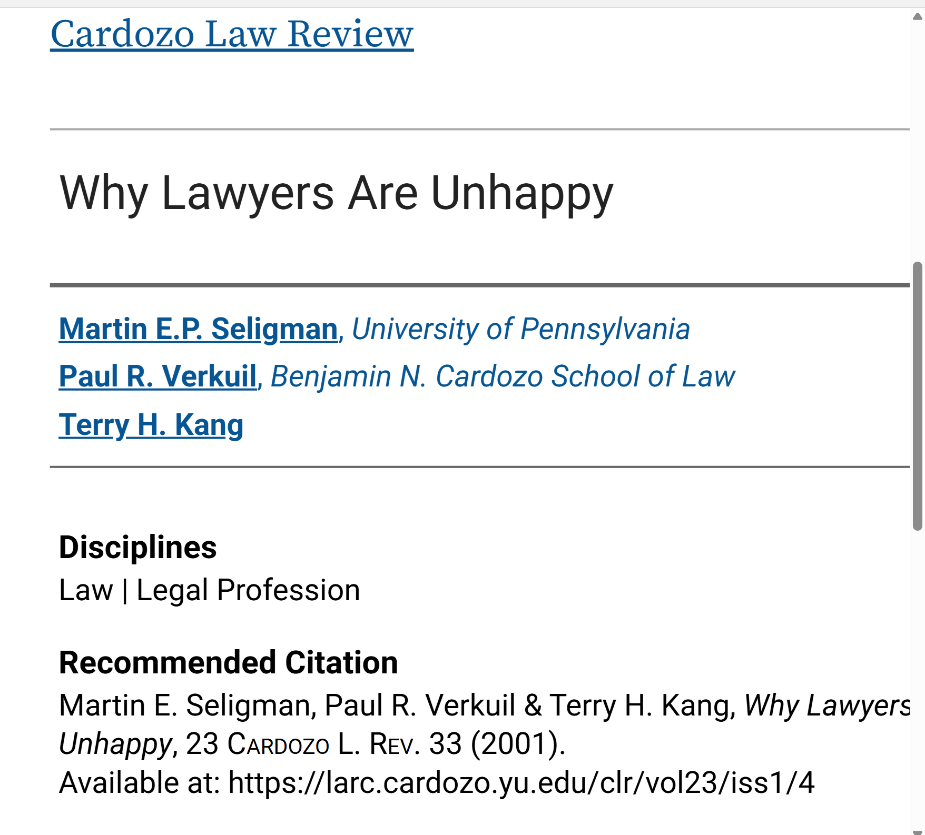

Slide 33
LAPs + 50 years of research + decades of reforms yet still minimal meaningful impact

Slide 34
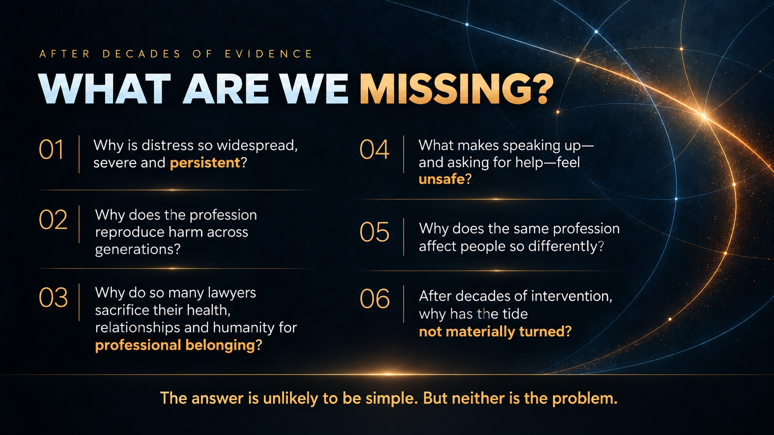

Slide 35
I needed to try and figure this out.
Maybe it could help explain my life

Slide 36


PROBLEM SOLVING 101
DIAGNOSING ROOT CAUSES
NOT TREATING SYMPTOMS
STEP 1: Admit a problem exists.
STEP 2: Diagnose the true cause.
STEP 3: Address the root cause – not only the symptoms.

Slide 37
“When you’re conditioned to do something you’re not even aware you’re doing it” - Anita Moorjani

Slide 38
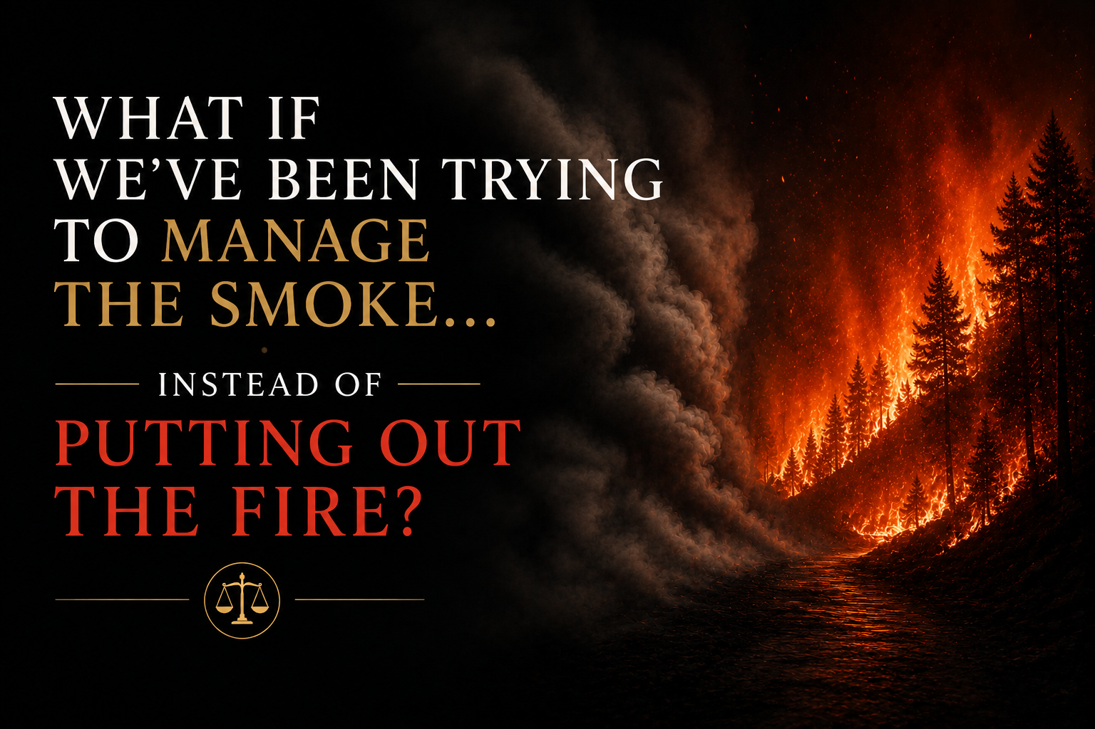

Slide 39



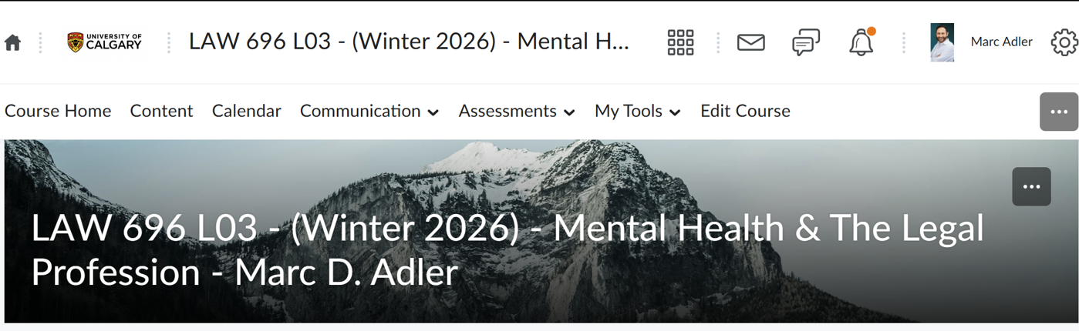
THE RESEARCH WAS CLEAR: IT USUALLY ALL STARTS IN LAW SCHOOL
Yet despite decades of research, in 2024 there was not one course offered in AB law schools on Mental Health (only one course in Canada).
So I decided to create one and teach it…

Slide 40
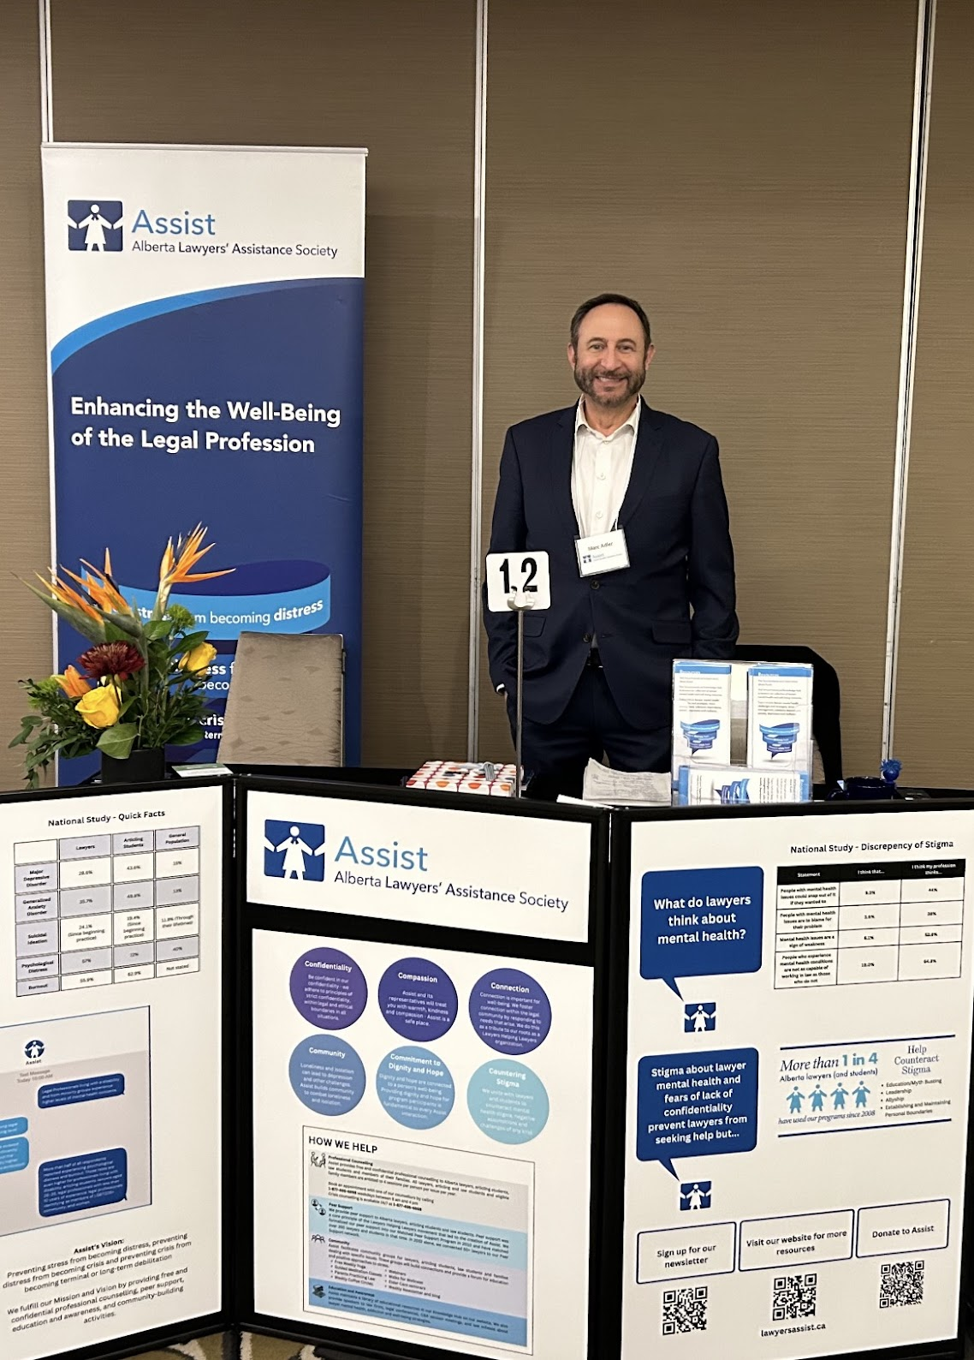
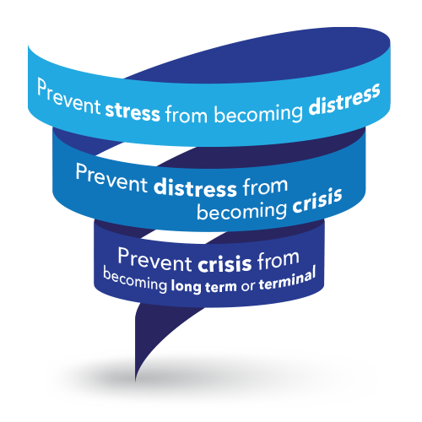
THAT LED ME TO ASSIST

Slide 41
WHO DOES ASSIST HELP?
Law Students
Articling Students
Lawyers
and their dependent families

Slide 42
SINCE 1996
30 YEARS OF SAVING LIVES
Free.
Confidential.
Fully independent.
Helped thousands across Alberta and Nunavut.

Slide 43
Professional Counselling Key Details
4 sessions per person per issue per year
Registered Psychologists (10 years minimum experience: knowledgeable about the unique aspects of the legal profession)
24/7 CRISIS COUNSELLING

Slide 44

4 PILLARS OF SUPPORT
Peer Support
Matched One on One Peer Support Mentorship.
Education and Awareness: www.lawyersassist.ca
Walks for Wellness—September
Webinars and Presentations (Law firms, Law schools, Law Societies, CBA, CLG, PBLA, etc.)
Weekly newsletter (800 subscribers)
Community Programming
Weekly Online Red Mug Coffee Circles
Free weekly Yoga and Mindfulness classes
Parenting, elder care, neurodiversity, trauma, etc
PROFESSIONAL COUNSELLING
Free. Registered psychologists trained on lawyer distress.
24/7 Crisis Counselling
Proactive

Slide 45
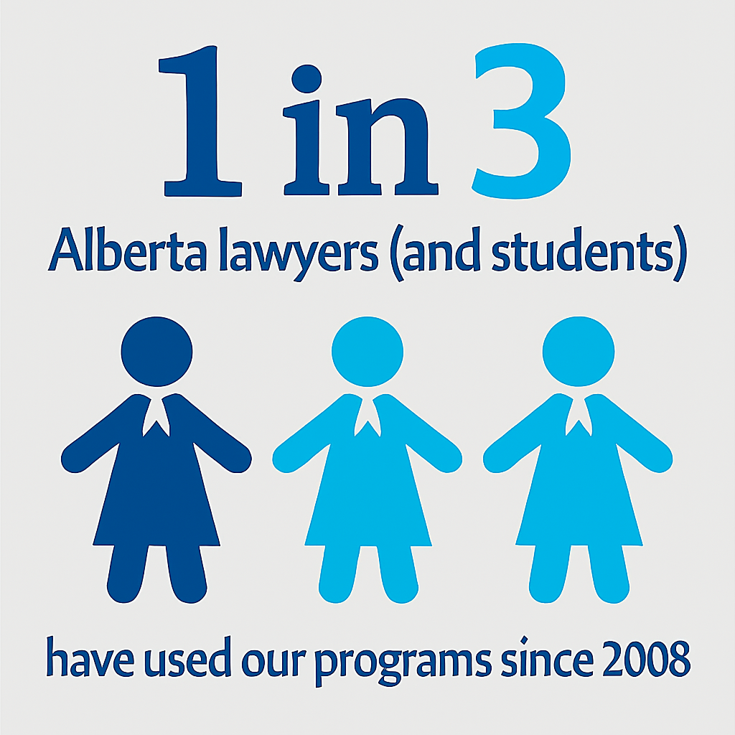
BREAKING THE STIGMA!

Slide 46
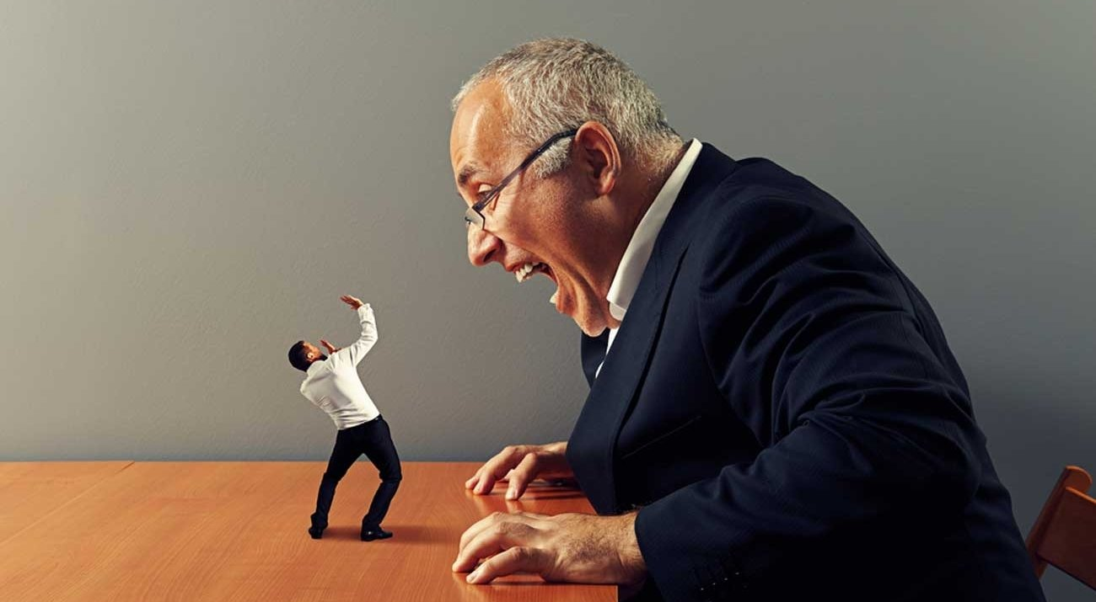
PART 3: BULLYING AND INCIVILITY:
HOW SERIOUS IS THE PROBLEM?

Slide 47
WHAT IS WORKPLACE INCIVILITY?
A milder—but still serious—form of psychological abuse reflecting a lack of consideration and respect for others.
The 2022 National Study measured:
  Being put down or treated with condescension
  Having your judgment doubted on a matter under your responsibility
  Having little attention paid to what you say or little interest shown in your opinion
It may appear minor in isolation—but it can accumulate, escalate and cause serious harm.
Source: Cadieux et al. (2022), adapted from Cortina et al. (2001).

Slide 48
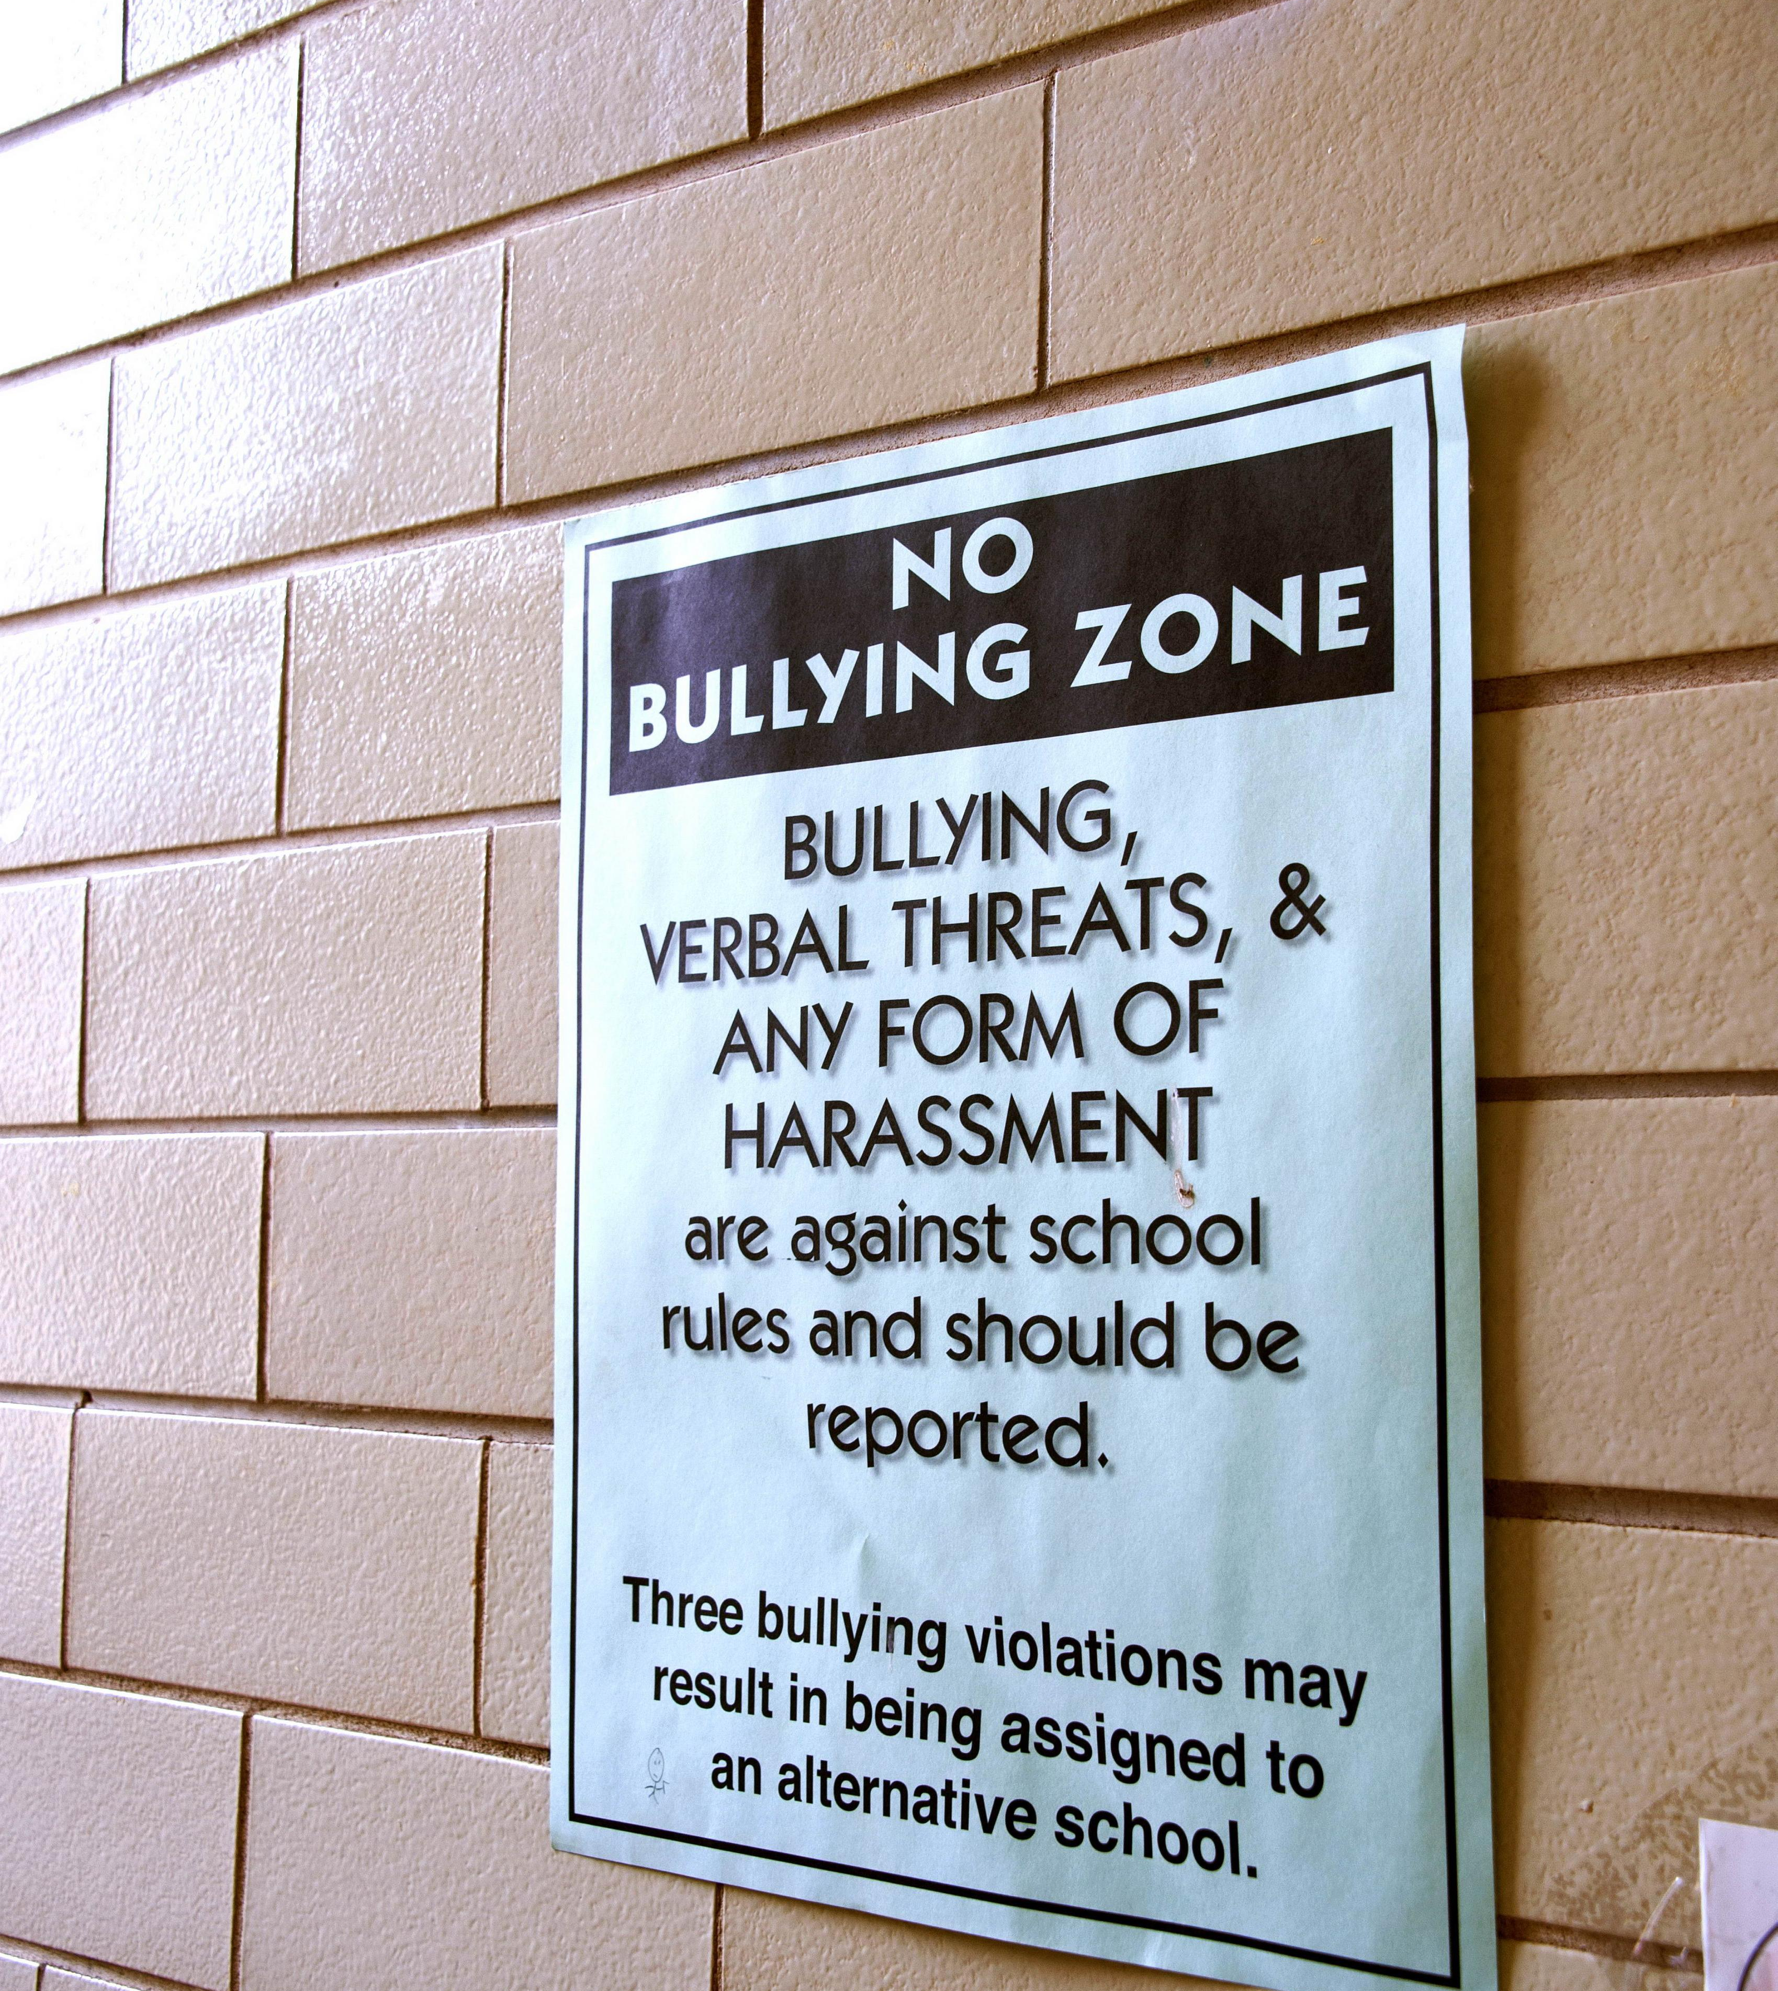
WHEN DOES IT BECOME BULLYING?
repeated exposure to unpleasant or degrading treatment—where the person finds it difficult to defend themselves.
REPETITION + POWER IMBALANCE
Source: Cadieux et al. (2022)

Slide 49
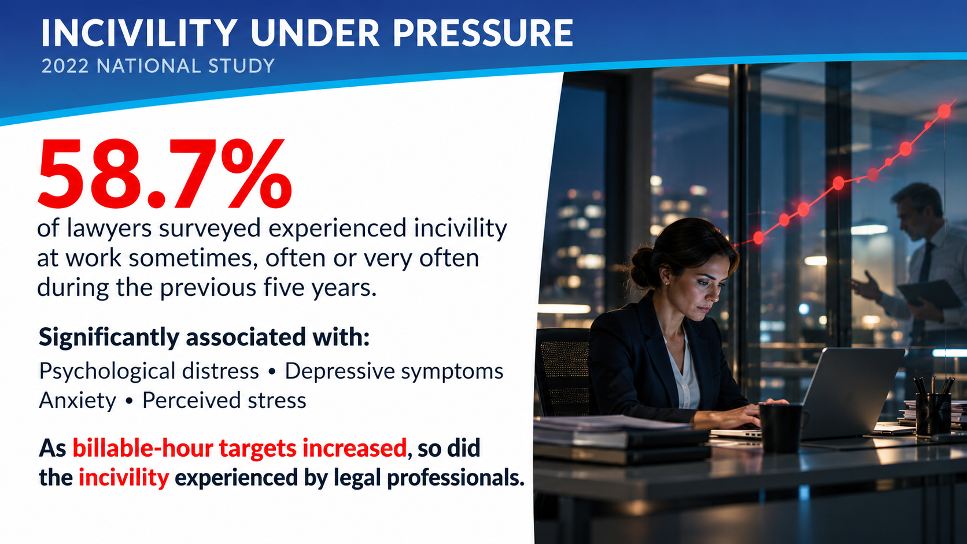
• 58.7% of all lawyers surveyed reported experiencing incivility at work sometimes, often or very often during past 5 years.
• Found incivility significantly associated with greater psychological distress, depressive symptoms, anxiety and perceived stress.
• As billable-hour targets increased, so did the

Slide 50
MOST VULNERABLE
EXPERIENCING MOST INCIVILITY and VIOLENCE
LPs with disabilities (76%)
Young LPs (0 - 9 years) (73.2%)
LGBTQ2S+ (72%)
Women LPs (69%)
Ethnicized LPs(64%)
Source: Cadieux et al. (2022)

Slide 51
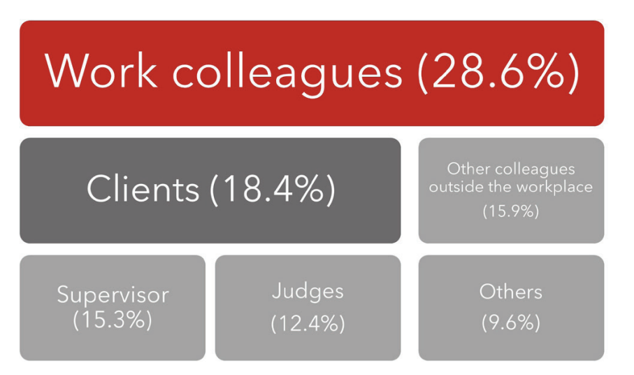
Sources of Incivility:
WE ARE DOING IT TO ONE ANOTHER
In 72.2% of the cases, uncivil and violent acts originate directly from the legal community, be it colleagues, superiors, or judges.
Notes:
Clients accounted for 18.4%. But almost three-quarters of this conduct came from inside our own professional community. This is not principally something being done to lawyers by the outside world. We are doing it to one another.

Slide 52
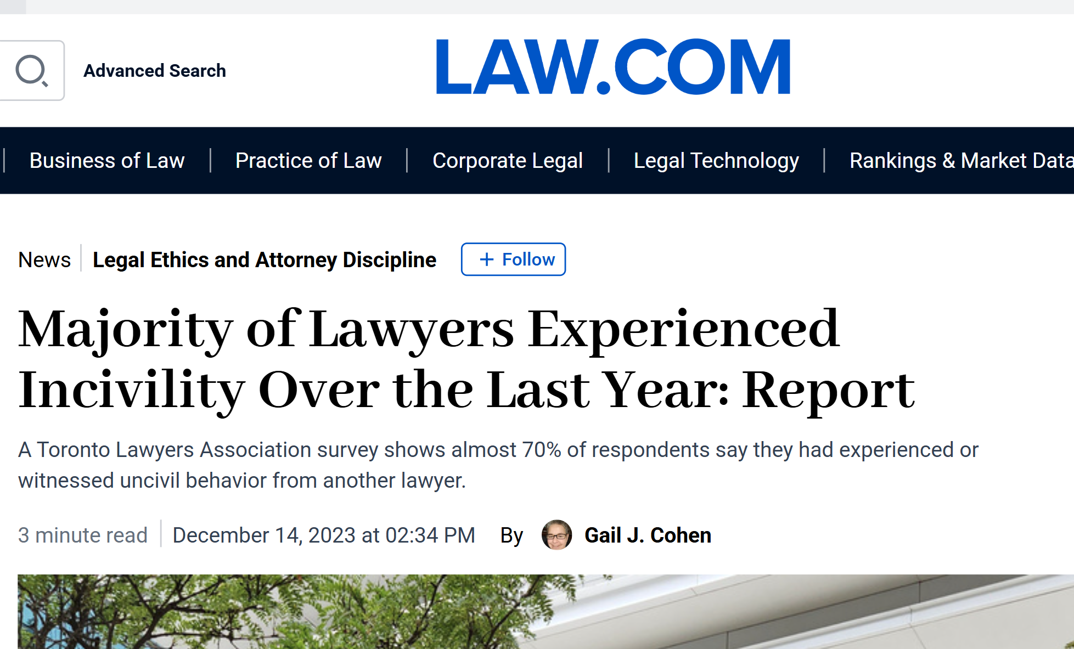

Slide 53
TLA 2023 Report: Same Problem
70% of lawyers in Toronto reported either experiencing or witnessing uncivil behaviour of another lawyer.
30% report incivility from decision-makers (judges, arbitrators, mediators).
Equity deserving groups disproportionately impacted.
Incivility linked to burnout, attrition, and reduced diversity.

Slide 54

WHEN BULLYING WORKS
“…a bullying, highly negative occupation where being a bully gets things done…leads to career and financial success in an adversarial system.”
“clients expect it and firms directly or indirectly reward it.”
Legal professional quoted in the 2022 National Study, p. 327.

Slide 55
THE 2022 REPORT’S ANSWER:
NOT INDIVIDUAL: IT’S SYSTEMIC
MEANINGFUL ACCOUNTABILITY
  Clear standards and actual consequences
INDEPENDENT COMPLAINT PROCESSES
  Safe reporting and external investigation
EDUCATION AND MENTORING
  Prevent incivility rather than merely reacting to it
LEADERSHIP BY EXAMPLE
  Partners, managers and judges must model the standard
Among the recommendations of the 2022 National Study.
Notes:
“Notice where the report places responsibility. It does not tell the person being bullied simply to become tougher or more resilient. Its recommendations are directed primarily at the institutions and people with power to change the conditions

Slide 56
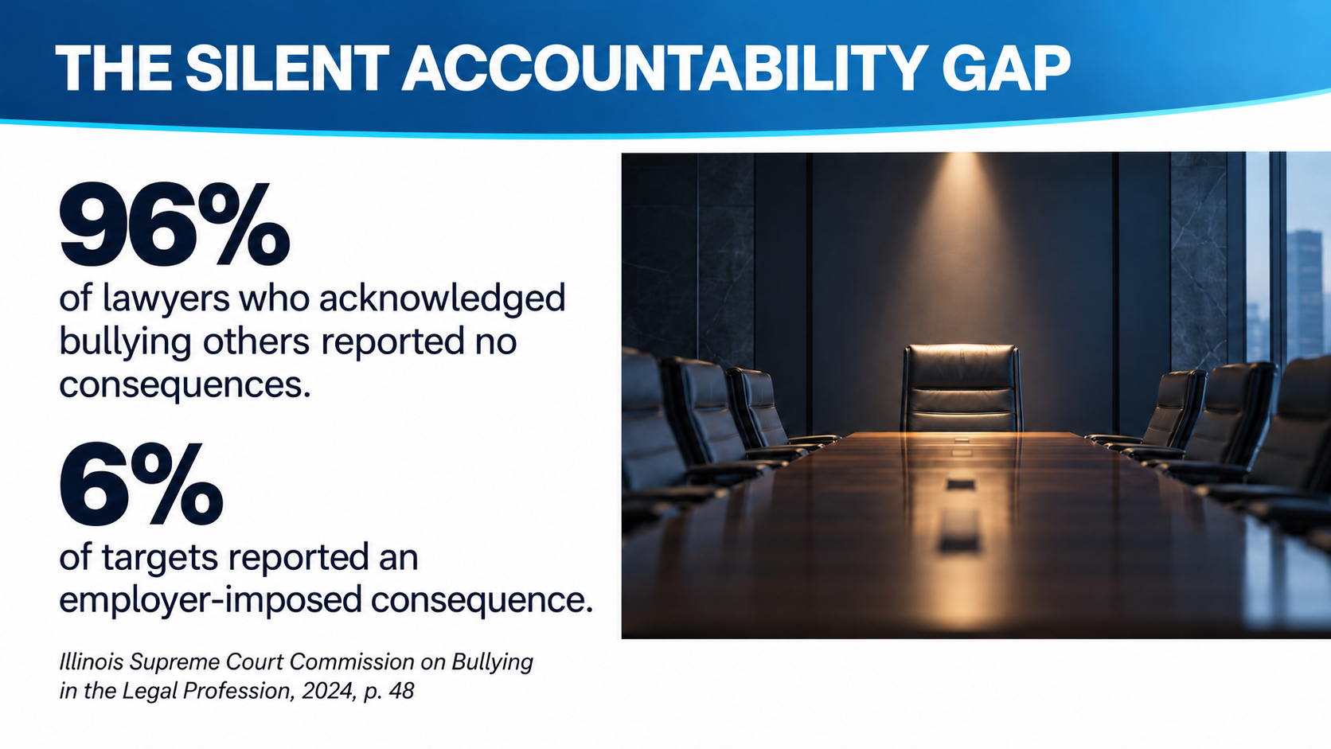

Slide 57
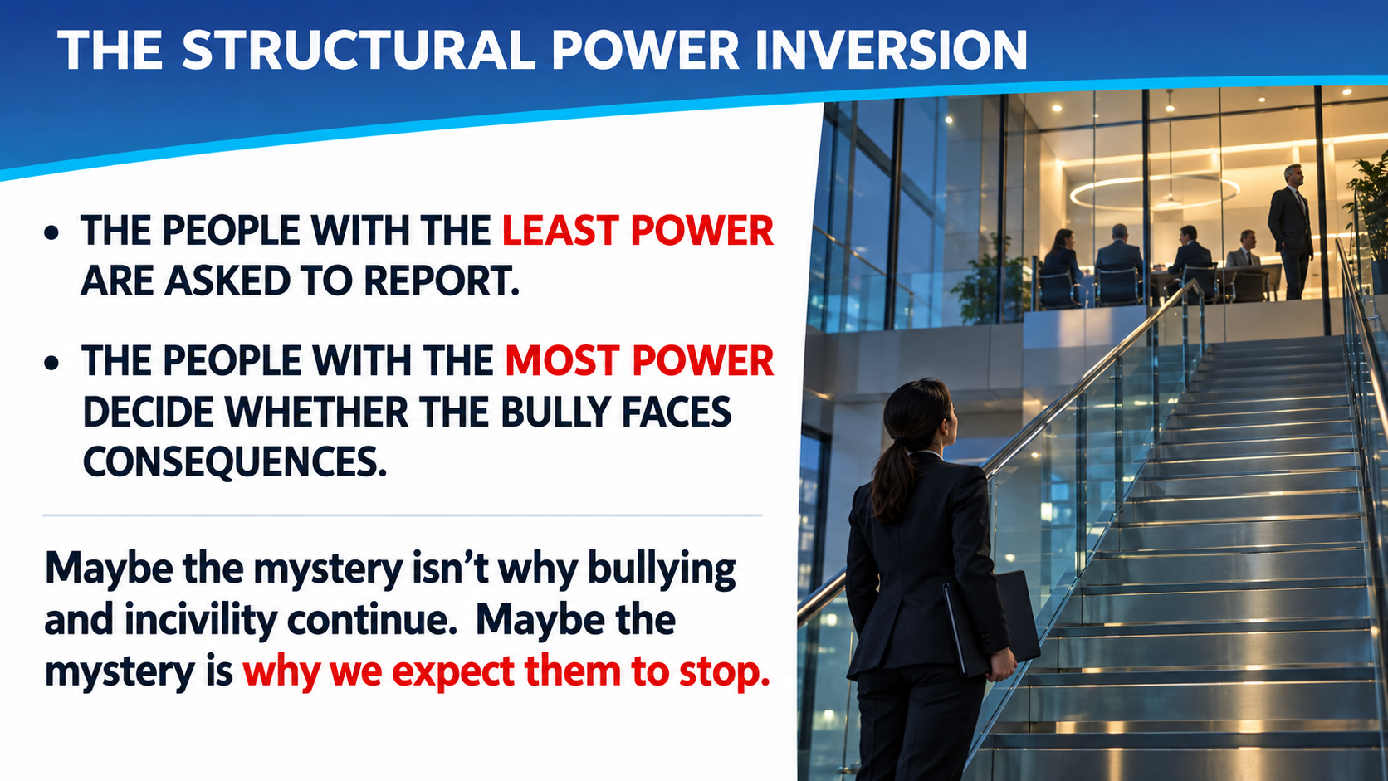

Slide 58
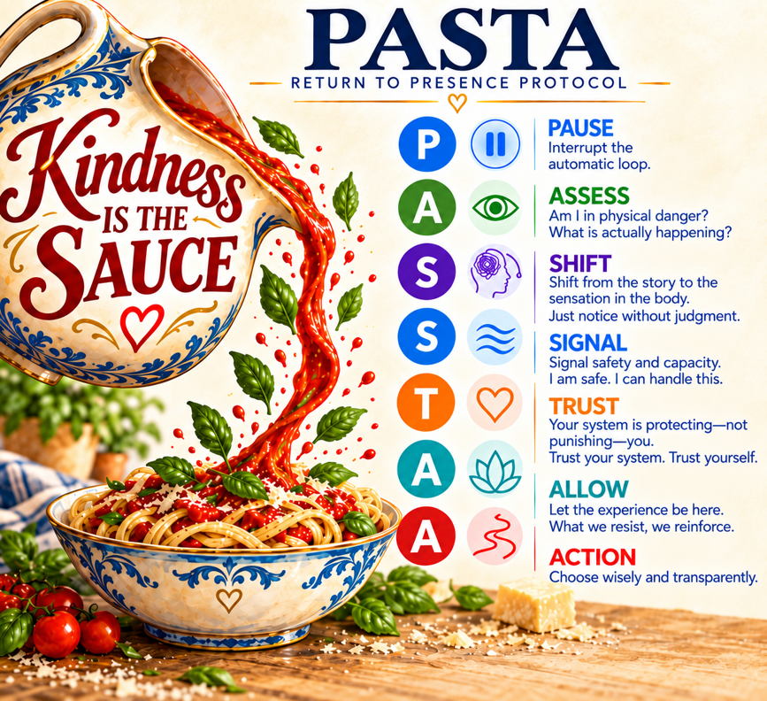
What IS ONE THING WE CAN DO?
Give ourselves time and space to respond
Between stimulus and response, there’s a space. In that space lies our freedom and power to choose our response. In our response lies our growth and freedom.

Slide 59
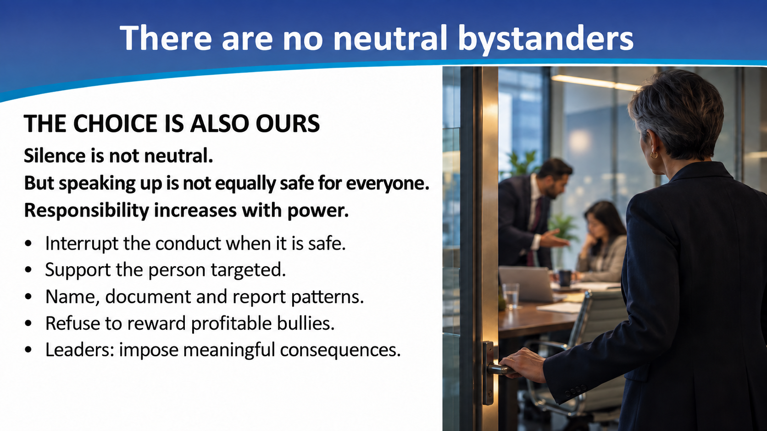

Slide 60

GROIA: Civility matters, but…
WHEN DOES RESOLUTE ADVOCACY CROSS THE LINE?
“Trials are not—nor are they meant to be—tea parties.”
Groia v. Law Society of Upper Canada, 2018 SCC 27
When does forceful advocacy become professional misconduct?
How did the Supreme Court draw that boundary in Groia?
Did Groia make incivility harder to regulate—or chill regulators from trying?

Slide 61

INCIVILITY AND BULLYING IN PRACTICE
Impact of Groia: Bullying as a Strategy
35 years experience.
Administrative Law across Alberta, NWT, Nunavut, and Yukon.
Managing Partner and KC.
Prosecution counsel in professional discipline proceedings and counsel to professional regulators.
Peer mentor and long-time supporter of Alberta Assist

Slide 62


Slide 63
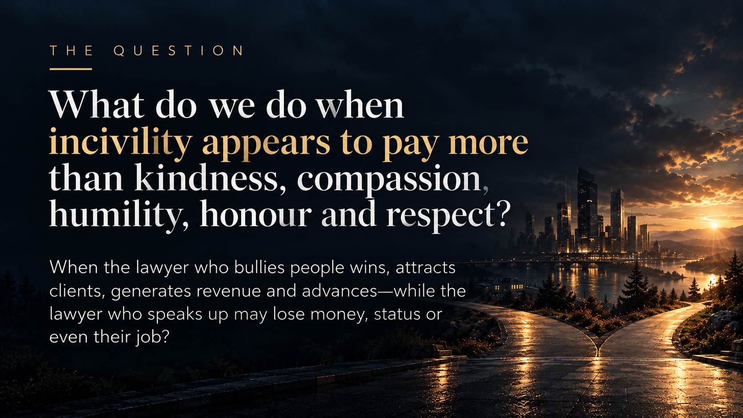

Slide 64
MAKING LAW MORE HUMANE
ONE HUMAN AT A TIME
"Individually, we are one drop. Together, we are an ocean."
– Ryunosuke Satoro, Japanese writer (1892-1927)
WE MAY WORK IN AN ADVERSARIAL SYSTEM.
BUT THAT DOESN’T MEAN WE MUST BE ADVERSARIAL
WITH THE HUMANS DOING THE LAWYERING.
STARTING WITH OURSELVES.

Slide 65


Slide 66
Contact Info
Marc D. Adler: 1-587-779-7203
Programdirector@lawyersassist.ca
Assist Website:www.lawyersassist.ca
Craig Boyer: craig@shoresjardine.com
https://shoresjardine.com/lawyers/craig-boyer/

