Slide 1


Trademark Law for the Yukon Corporate Commercial Practitioner

Slide 2
When do trademark law issues come up?

Slide 3

New business, product or service
Growing and haven’t considered before
Consider whenever a client is investing in the brand and building significant goodwill
Would it be costly and a set-back to have to change the name and rebrand?

Slide 4
CLEARANCE SEARCHING BEFORE ADOPTION
Not the same as registered trade name
CIPO for registered trademarks
  https://ised-isde.canada.ca/cipo/trademark-search/srch
Some indication with simple “direct hit” search
Test is confusion –
    not registrable if confusing with registered trademark,
    Infringing other’s rights if using a confusingly similar trademark
October 20, 2026
4

Slide 5

TEST FOR CONFUSION
A trademark is confusing with another trademark if using both trademarks in the same area would be likely to lead to the inference that the goods or services associated with those trademarks are manufactured, sold, leased, hired or performed by the same person… (S. 6(1))
October 20, 2026
5

Slide 6
TEST FOR CONFUSION
Factors:
  (a) the inherent distinctiveness of the trademarks and the extent that they have become known;
  (b) length of time they have been in use;
  (c) the natures of the goods, services or business; (c) the nature of the trade; and,
  (d) the degree of resemblance between the trademarks including in appearance or sound or in the ideas suggested by them. (s.6(5))
October 20, 2026
6

Slide 7
CONSIDER CONFUSION & DISTINCTIVENESS
Klondike
Aurora
Wild
North, Northern
Adventure
Yukon
Arctic
Alpine
Borealis
October 20, 2026
7

Slide 8
INCLUDE COMMON-LAW USES
Unregistered trademarks – accrue rights through use in a specific geographic area
Protected under S. 7(b), passing off action – difficult
Must show
  Goodwill or reputation attached to goods, services
  Deception of the public through a misrepresentation, resulting in actual or likely confusion
  Actual or potential damage
internet search, social media searches, domains …
October 20, 2026
8

Slide 9
BENEFITS OF REGISTRATION
Exclusive rights across Canada rather than confined to area of business
Easier to enforce – no need to prove ownership, reputation, goodwill
Easier to commercialize - assign, license, franchise, use for financing
Public notice – appears on public register and can prevent others from adopting similar trademark
October 20, 2026
9

Slide 10
OTHER BARS TO REGISTRATION
Is the name in any language of any of the goods or services with which it is used (S. 12(1)(c))
  Pescado Fish & Chips - NO
Whether depicted, written or sounded,
clearly descriptive or deceptively misdescriptive of the character or quality of the goods or services or of their place of origin (S. 12(1)(b))
  Cod N’ Batter Fish & Chips – NO
  Tastee Fish & Chips - NO
  Skagway Halibut Steaks - NO
October 20, 2026
10

Slide 11
ALSO NOT REGISTRABLE
A word that is primarily merely the name or the surname of an individual (living or died within 30 yrs)(S. 12(1)(a))
  Fred’s Diner – NO
  Diamond Tooth Gerties – YES
  McDonalds – YES
A trademark is registrable if it is distinctive at the application filing date having regard to all the circumstances (S. 12(3))
October 20, 2026
11

Slide 12
It’s registered,
now what?
®

Slide 13
MUST CONTINUE TO USE
Expungement - When a trademark is not used, the registration is liable to be expunged (S. 45(3))
Enforcement– a registration of a trademark gives the owner the exclusive right to use it throughout Canada, unless shown to be invalid (S. 19)
Invalid if abandoned – a registration is invalid if the trademark has been abandoned… (S. 18(1))
October 20, 2026
13

Slide 14

USE AS A TRADEMARK -GOODS
At the time of the transfer of the property in or possession of the goods, in the normal course of trade, it is marked on the goods or their packaging or is associated with the goods in another matter that provides notice to the purchaser (s. 4(1) TMA)
October 20, 2026
14

Slide 15

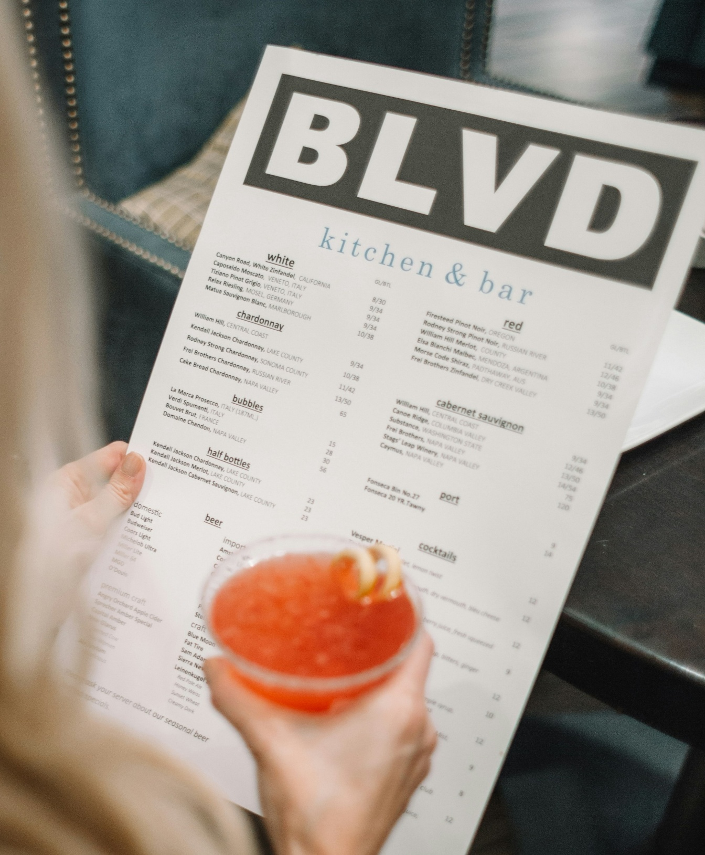
USE AS A TRADEMARK - SERVICES
used or displayed in the performance or advertising of those services. (s. 4(2))
October 20, 2026
15

Slide 16
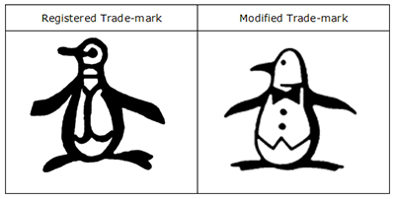
USE CONSISTENTLY IN THE FORM REGISTERED
Promafil Canada Ltée v. Munsingwear Inc. (1992), 44 C.P.R. (3d) 59 (F.C.A.)
The test is whether:
    the trademark remains recognizable;
    its dominant features have been preserved; and
    the differences are sufficiently minor that they would not mislead an unaware purchaser.
Canada (Registrar of Trade Marks) v. CII Honeywell Bull, [1985] 1 F.C. 406 (F.C.A.)
    CII HONEYWELL BULL vs BULL
October 20, 2026
16

Slide 17
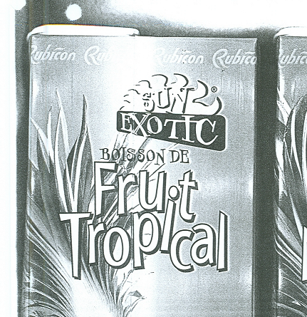
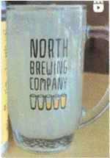


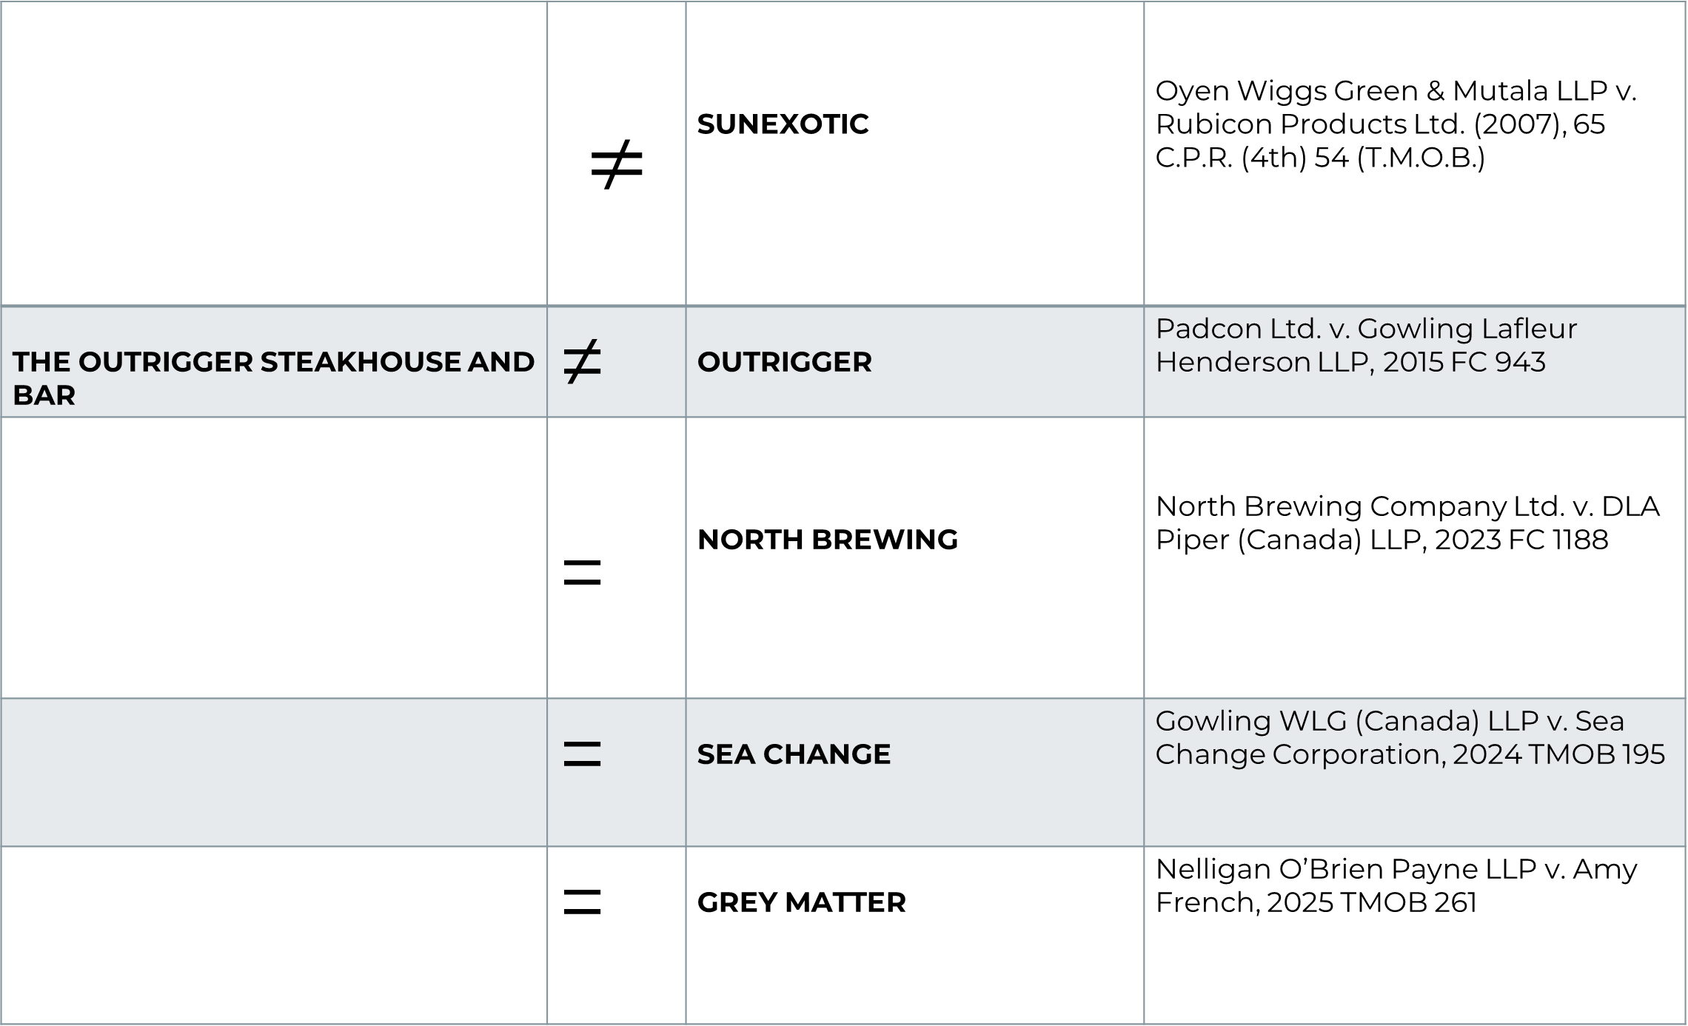
 | $$≠$$ | SUNEXOTIC | Oyen Wiggs Green & Mutala LLP v. Rubicon Products Ltd. (2007), 65 C.P.R. (4th) 54 (T.M.O.B.)
THE OUTRIGGER STEAKHOUSE AND BAR | ≠ | OUTRIGGER | Padcon Ltd. v. Gowling Lafleur Henderson LLP, 2015 FC 943
 | = | NORTH BREWING | North Brewing Company Ltd. v. DLA Piper (Canada) LLP, 2023 FC 1188
 | = | SEA CHANGE | Gowling WLG (Canada) LLP v. Sea Change Corporation, 2024 TMOB 195
 | = | GREY MATTER | Nelligan O’Brien Payne LLP v. Amy French, 2025 TMOB 261
October 20, 2026
17

Slide 18
MUST ENFORCE AGAINST OTHERS
The registration of a trademark is invalid if the trademark is not distinctive at the time proceedings bringing the validity of the registration into question are commenced (s. 18(1)(B))
If could be confusing – cease and desist letter
October 20, 2026
18

Slide 19

What else should a business or their lawyer keep in mind?

Slide 20

LICENSING
If an entity is licensed to use the trademark and the owner has, under the licence, direct or indirect control of the character or quality of the goods or services, then the use of the trademark by that entity has the same effect use by the owner. (s. 50(1))
Milano Pizza Ltd. v. 6034799 Canada Inc., 2023 FCA 85-
    Insufficient to require licensees to purchase ingredients, pizza boxes and drinks from authorized distributors
    Control over the finished product or service is required to ensure consistent quality across all products
20

Slide 21
LICENSING
If the licensee gives notice that the use is licensed and the identity of the owner, it is presumed that the use is licensed and the owner has control over the character or quality of the goods or services (s. 50(2))
“[MARK] is a trademark of [OWNER] and is used under licence.”
21

Slide 22


RELATED COMPANIES
Even with related companies it is important to document license agreement and control, and assignments
Cathay Pacific Airways v. Air Miles Intl. (2014), 456 F.T.R. 197 (FC)
Court reviewed circumstances and found that Cathay had control over the character and quality of the services and an implied license – but don’t rely on this
Holdco
License agreement + control
use
October 20, 2026
22

Slide 23

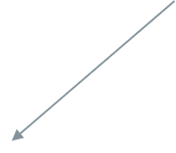

CORPORATE RE-ORGS
Grayling Watercrafts Inc.
Grayling Watercrafts Inc.
Assets of Division A
Division A - canoes
Division B - motorboats
Grayling Canoes Inc.
Grayling Motorboats Inc.
GRAYLING trademark – registered for use with canoes, kayaks, motorboats, retail sale of the same
October 20, 2026
23

Slide 24
TRANSACTIONS
When a lot of goodwill attached to the brand
What marks does the business use – both registered and unregistered
Who owns them – does the vendor own them or does the founder or a related entity? Were they properly assigned?
Are the rights valid – compare registrations with actual use, is it being enforced against infringers?
Review purchaser and third-party licenses
Security interests?
Does purchase agreement expressly deal with trademarks? Show a clean chain of title.
October 20, 2026
24

Slide 25
SECURITY AGREEMENTS
For example – vendor financed purchase of business with significant goodwill attached to brand
Under PPSA, intangible personal property
trademark specific security agreement or general security agreement with trademark-specific terms
Register in personal property registry
And record with CIPO – provides additional public notice of security interest – prevent unnoticed transfer
October 20, 2026
25

Slide 26
SECURITY AGREEMENTS
Security agreement should include:
  Registered and unregistered trademarks
  Include trademark applications, registrations, renewals and replacement marks
  Associated goodwill
  Restrictions on assignment, sublicensing, change of control
  Rights to sue for infringement (before and after default)
  Requirement to renew registrations, prosecute applications, use trademarks, defend material challenges
October 20, 2026
26

Slide 27
Are there other marks applicable to Yukon entities?

Slide 28
OFFICIAL MARKS
a badge, crest, emblem or mark
adopted and used
by a public authority, in Canada
as an official mark for goods or services,
in which the Registrar has given public notice of the adoption and use (s. 9(1)(n)(iii))
If meets these – another entity cannot use mark that is the same or likely to be mistaken for official mark
October 20, 2026
28

Slide 29




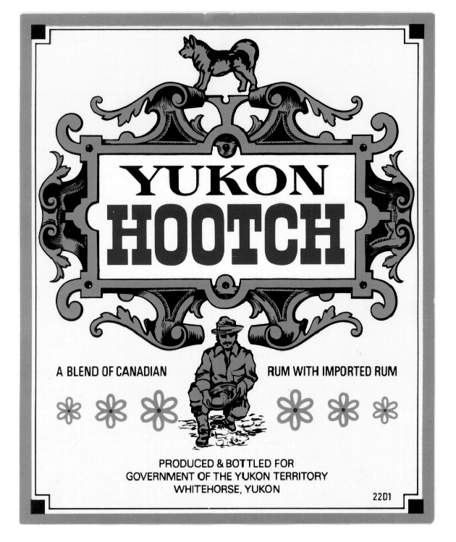
OFFICIAL MARKS
WHITEHORSE GENERAL HOSPITAL
October 20, 2026
29

Slide 30








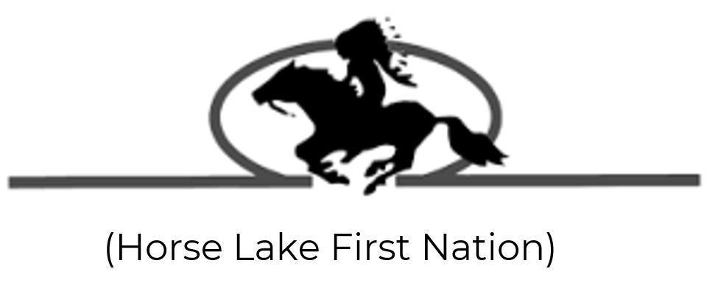

FIRST NATIONS’ OFFICIAL MARKS
SPIRIT BEAR
October 20, 2026
30

Slide 31
FIRST NATIONS’ OFFICIAL MARKS
The First Nation must establish:
  It is a public authority in Canada –
  It has adopted and used the mark as an official mark- should formally adopt it through a council resolution and use it publicly (on website, government documents, signage, etc.)
  Submit request to Trademarks Registrar with evidence
October 20, 2026
31

Slide 32
FIRST NATIONS’ OFFICIAL MARKS
Examples of evidence to provide:
  the First Nation’s final and self-government agreements;
  the applicable federal and Yukon implementing legislation;
  evidence of programs and services provided to citizens or the broader public;
  the resolution adopting the mark; and
  specimens showing public use of the mark.
October 20, 2026
32

Slide 33




FIRST NATIONS’ OFFICIAL MARKS
October 20, 2026
33

Slide 34
FIRST NATIONS’ OFFICIAL MARKS
Terrace (City) v. Urban Distilleries Inc., 2014 FC 833
Kitasoo Band Council and City of Terrace sought to enforce SPIRIT BEAR official mark against distillery in trademark opposition
Held the official mark to be unenforceable since although spirit bear had cultural significance, there was insufficient evidence that the mark was adopted and used prior to advertisement
October 20, 2026
34

Slide 35

Trademark issues in the modern world

Slide 36
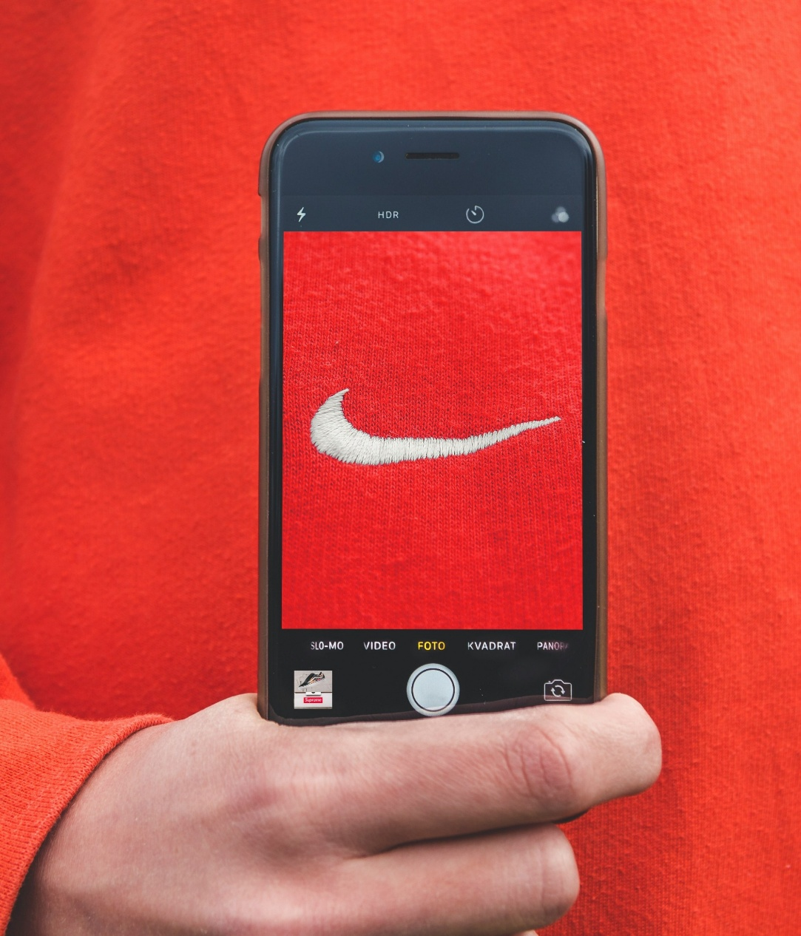


Slide 37
CHATGPT TERMS OF USE
Ownership of content. As between you and OpenAI, and to the extent permitted by applicable law, you (a) retain your ownership rights in Input and (b) own the Output. We hereby assign to you all our right, title, and interest, if any, in and to Output.
Similarity of content. Due to the nature of our Services and artificial intelligence generally, output may not be unique and other users may receive similar output from our Services. Our assignment above does not extend to other users’ output or any Third Party Output.
October 20, 2026
37

Slide 38
ISSUES WITH AI LOGOS
Don’t know where the idea came from – more important to do clearance searching
Copyright issues in design marks – don’t know if another entity has copyright and don’t own copyright yourself
Copyright shall subsist in Canada in every original literary, dramatic, musical and artistic work (5 (1)).
October 20, 2026
38

Slide 39
Questions?
Kristi Zychowka
kristi.zychowka@bluerocklaw.com
(403) 448-0702

